Slide 1
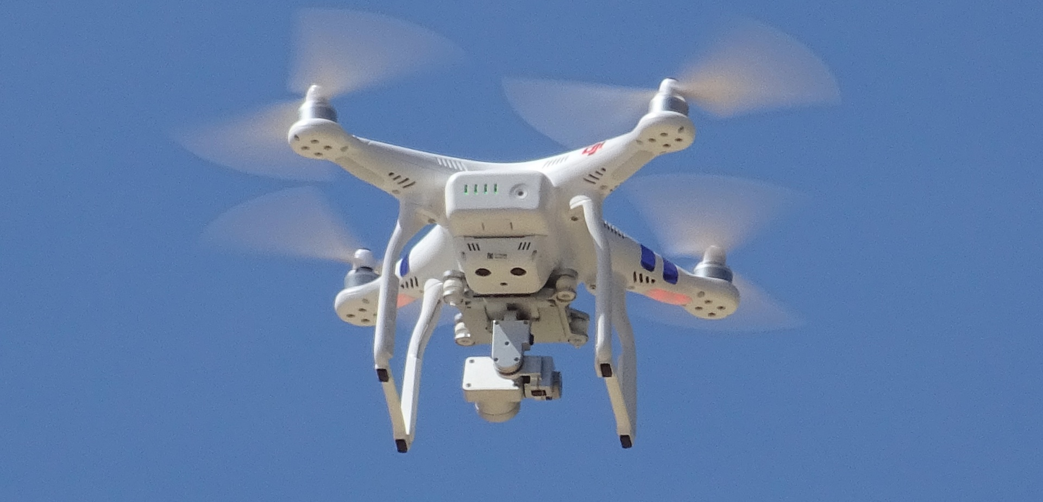
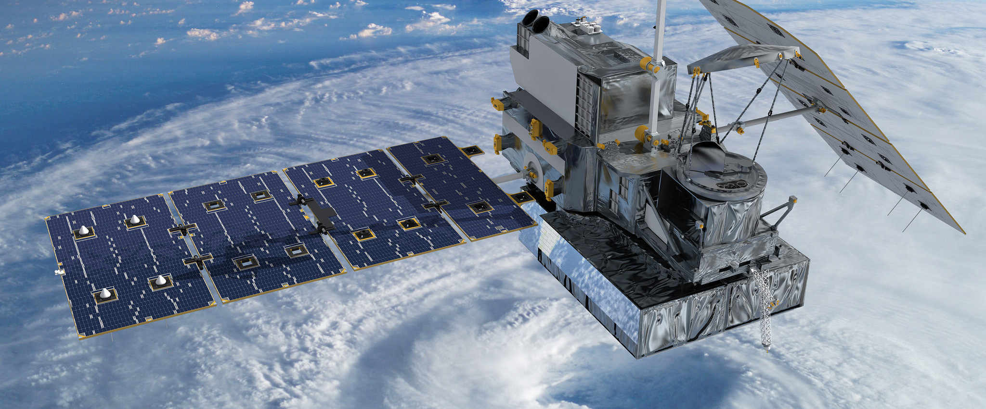
Introduction to Remote Sensing
This Photo by Unknown Author is licensed under CC BY

Slide 2
What is Remote Sensing?
Remote sensing is the process of detecting and monitoring the physical characteristics of an area by measuring its reflected and emitted radiation at a distance, or collecting images from satellites, aircraft, or Unmanned Aircraft System (UAS).
Remote sensing provides the raw data (images) used in GIS to create maps, perform spatial analysis, and gain insights into our dynamic planet.

Slide 3
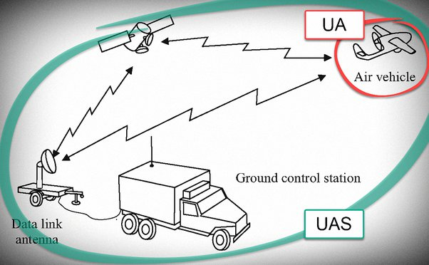
Unmanned Aircraft Systems (UAS)
UAV
Is a system that includes an unmanned aircraft, remote control station and wireless data link.
UAS

Slide 4
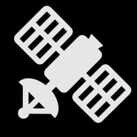
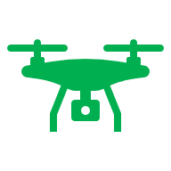
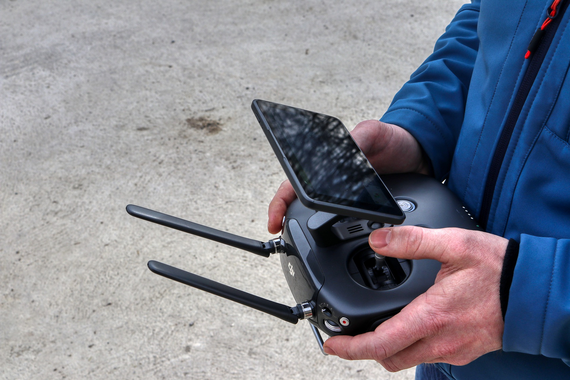
Unmanned Aircraft Systems (UAS)
GPS
UAV
Data Link
Antenna

Slide 5
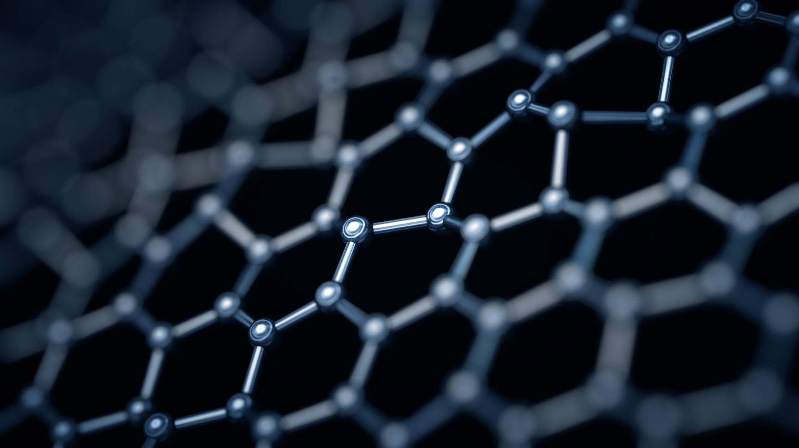
Types of Sensors
Sensors can vary greatly based on needs.
Some sensors can be changed out, while others can not and are permanently affixed to the UAV

Slide 6
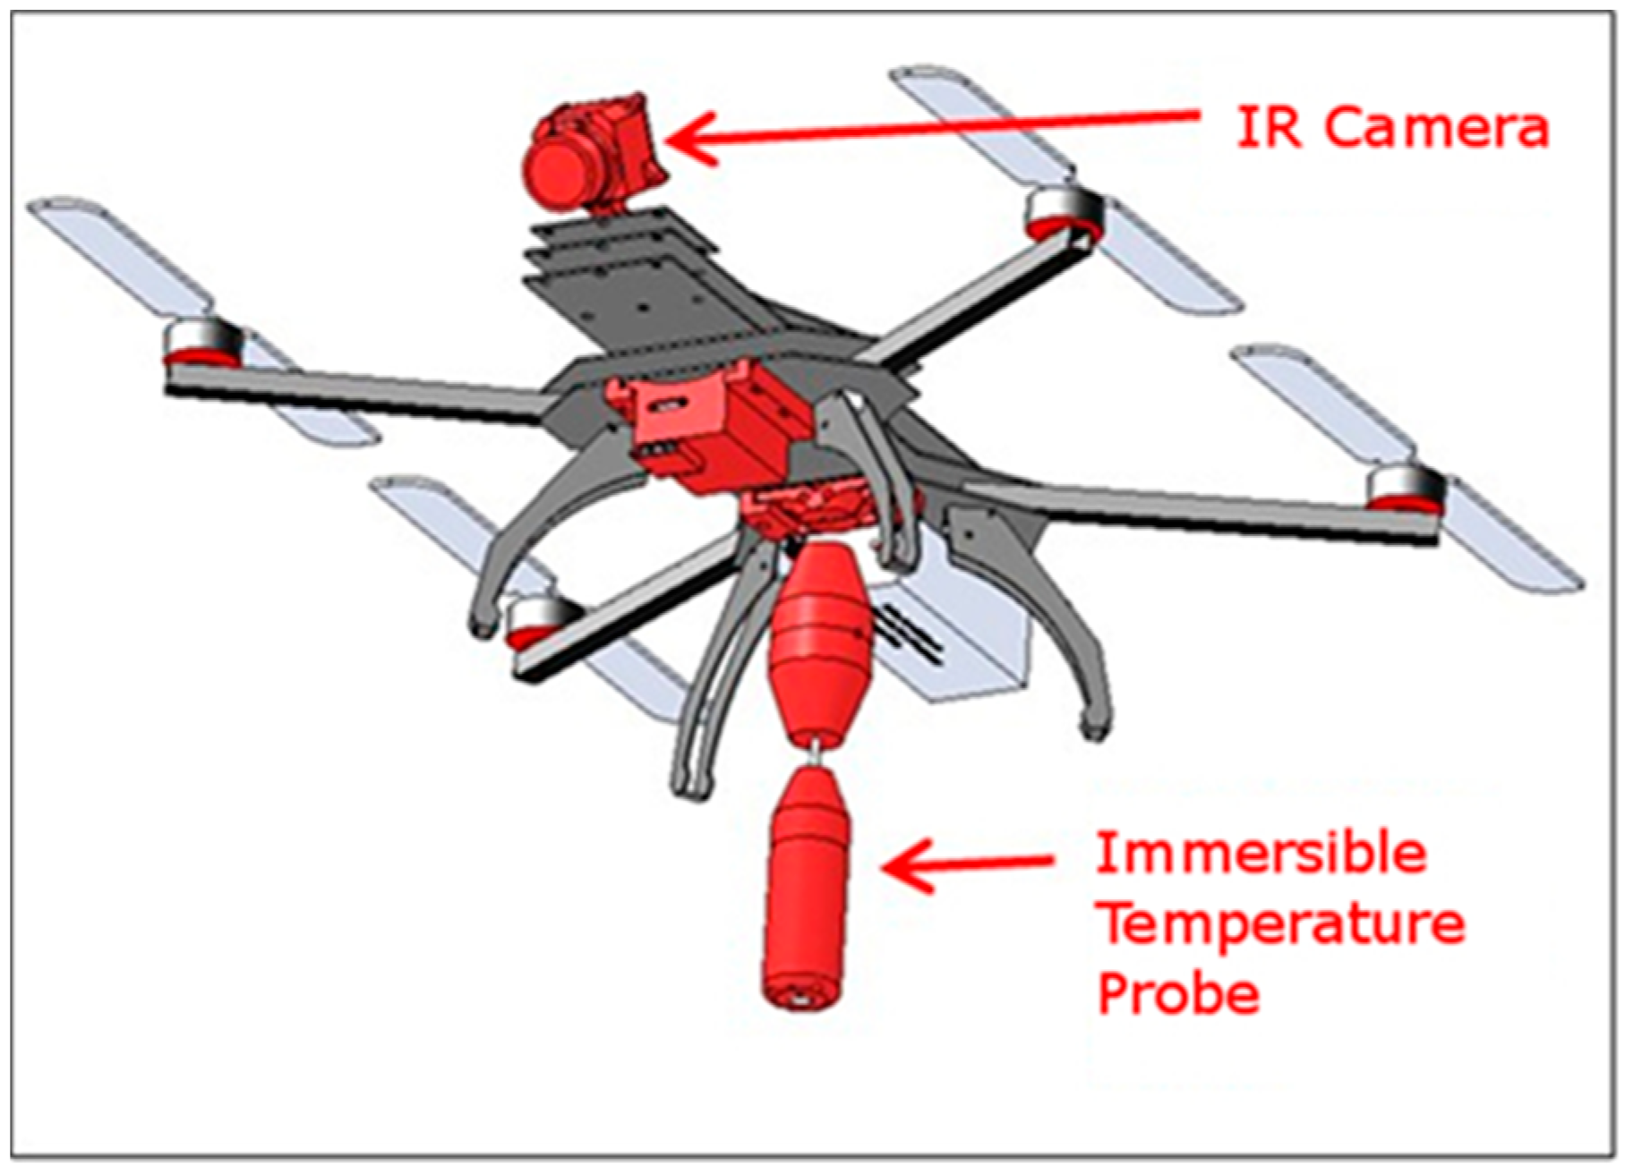

Slide 7
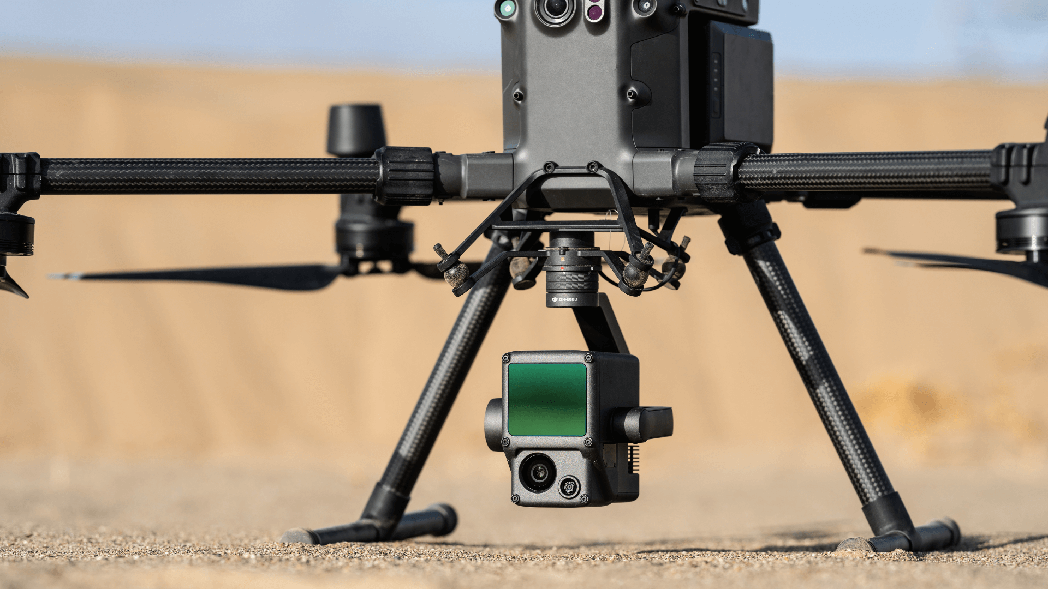
Lidar Sensor along with Thermal Camera

Slide 8
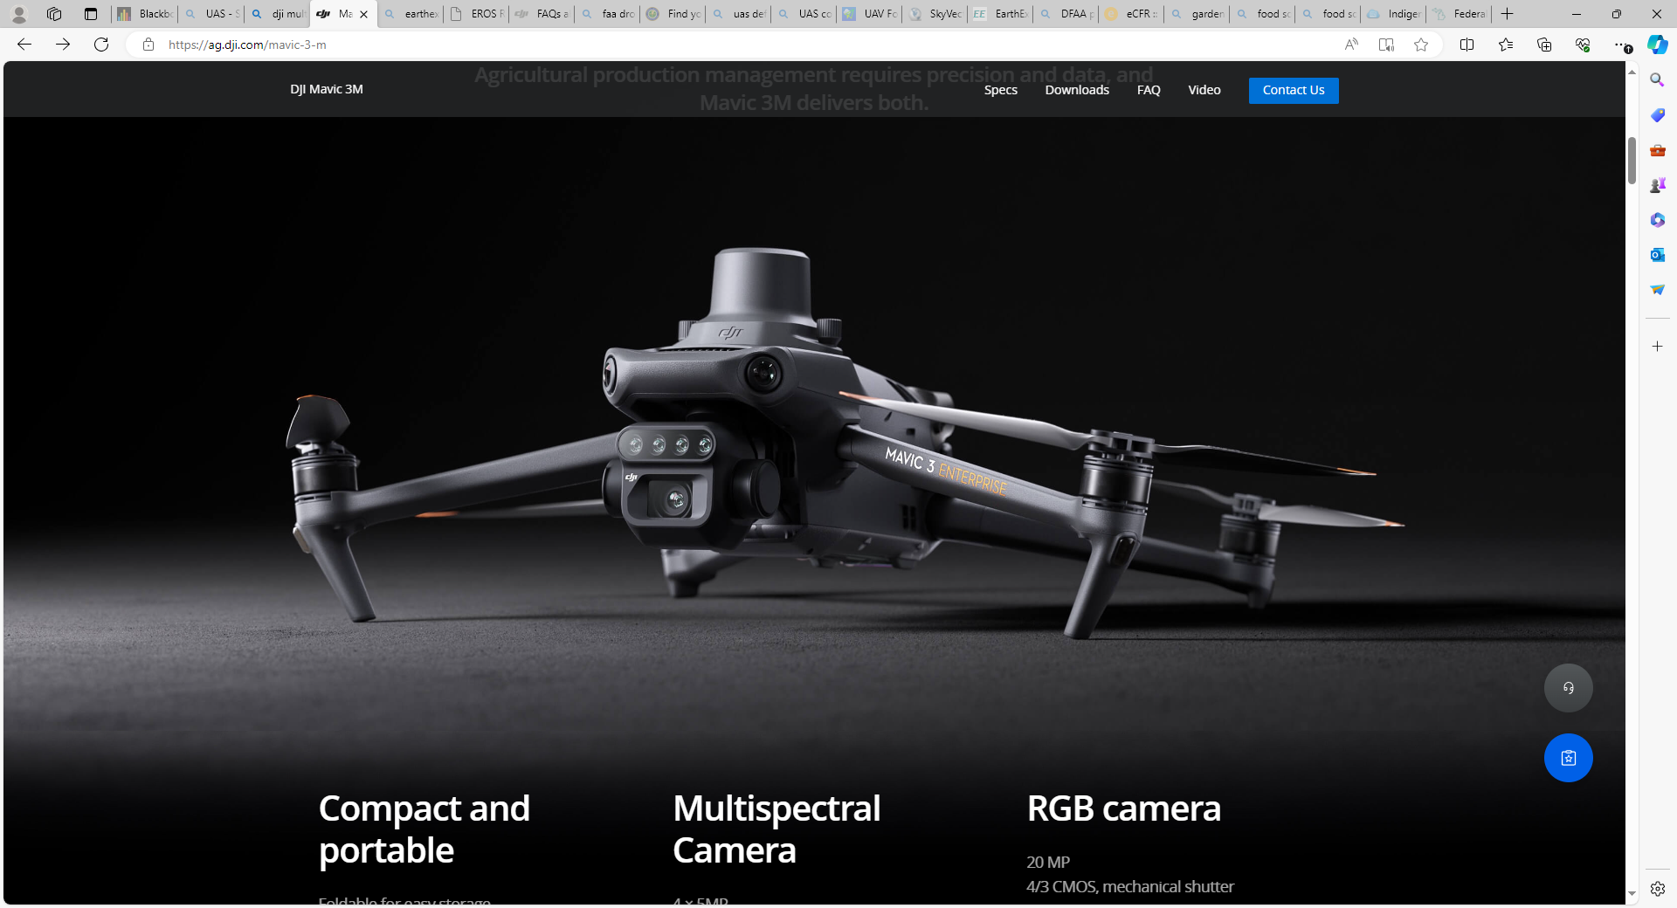
Multispectral Camera and RGB Camera

Slide 9
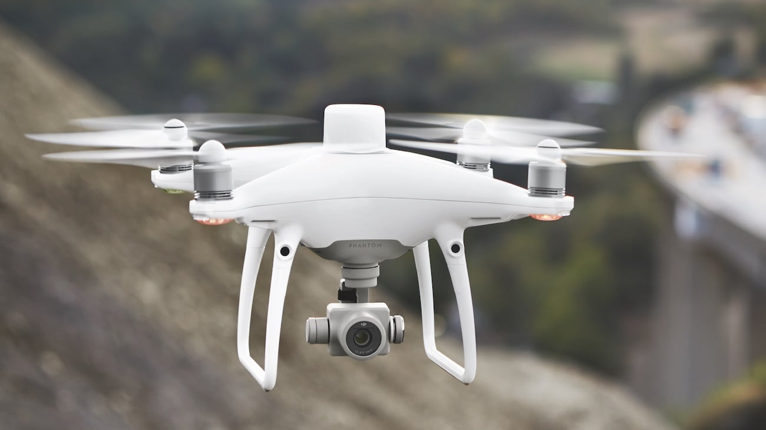
RGB Camera

Slide 10
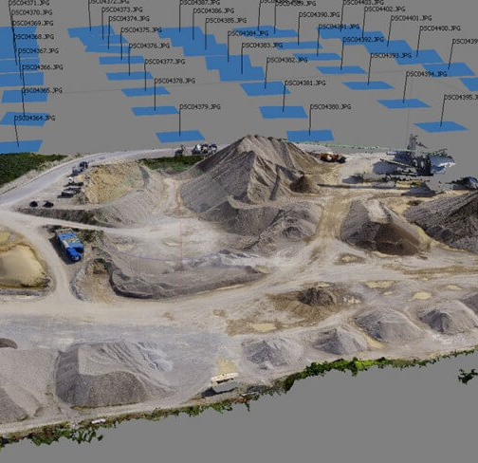
Image or Data Processing
Remote Sensing Images/Data vary across data type and images.
Images can be processed individually or constructed as an ortho-mosaic that is georeferenced.
Lidar needs special processing to be used in GIS.
Platforms that can be used for processing remote sensing data: Erdas Imagine, ArcGIS Pro, ArcGIS Drone2Map, and various other photogrammetry apps.

