Slide 1
IKONOS
GPY 370 Sensor Presentation

Slide 2
Overview of System
First U.S. commercial high resolution satellite
Operated by DigitalGlobe and was successfully launched on September 24, 1999 at Vandenberg Air Force Base, California
  Each international affiliate operates their own ground station
The overall objective was to offer commercial high resolution imagery with excellent location knowledge in near real-time and offline

Slide 3
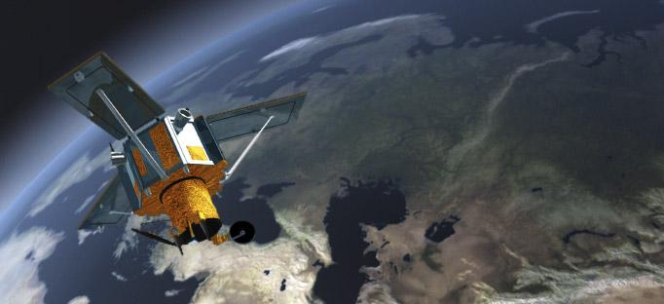
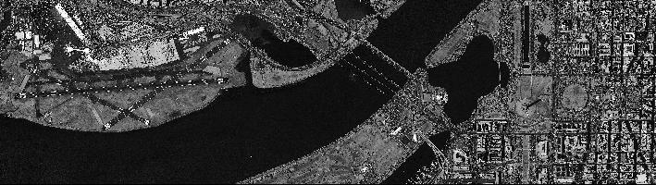
First IKONOS image taken of Washington D.C.
http://fas.org/irp/imint/space_imaging.htm

Slide 4
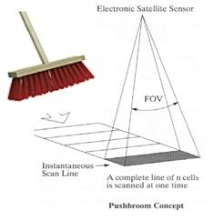
Characteristics
Orbit Elements:
  Altitude → 423 miles / 681 kilometers
  Orbital Period → 98 minutes, 14.6 revolutions per day
  Inclination → 98.1 degrees
  Swath Width → 11 kilometers
    Linear array technology / pushbroom

Slide 5
Key Parameters of IKONOS
Four multispectral bands at a spatial resolution of 4 meters as well as a 1 meter spatial resolution panchromatic band
  The panchromatic and multispectral bands can be combined to produce “pan-sharpened” multispectral imagery with an effective resolution of 1 meter
    Pan: 0.45 -0.90
    1 (Blue): 0.45 - 0.52
    2 (Green): 0.52 - 0.60
    3 (Red): 0.63 - 0.69
    4 (IR): 0.76 - 0.90
Radiometric Resolution → collects data with an 11-bit sensitivity and is delivered in unsigned 16-bit data format
Temporal Resolution → 3 days

Slide 6
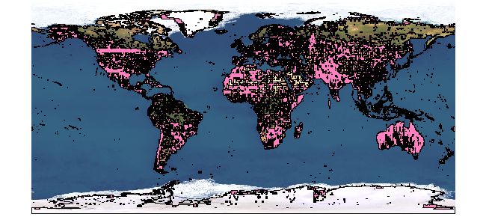
Data and Products
Imagery products provided in six levels: Geo, Standard Ortho, Reference, Pro, Precision, PrecisionPlus
Commercial data available to be purchased
  purchased by sq. km, so prices vary, but you only pay for exact area of interest
Geographic Coverage

Slide 7
Image Reference System
World Geodetic System (WGS) 84
  Defined with respect to station location
globally
  Helps for global survey
  Spheroidal Reference Surface (Reference Ellipsoid/Datum)
Coordinate of Origin: Earth’s center of mass with an error of 2 cm
http://en.wikipedia.org/wiki/World_Geodetic_System#mediaviewer/File:WGS_84_reference_frame.png

Slide 8
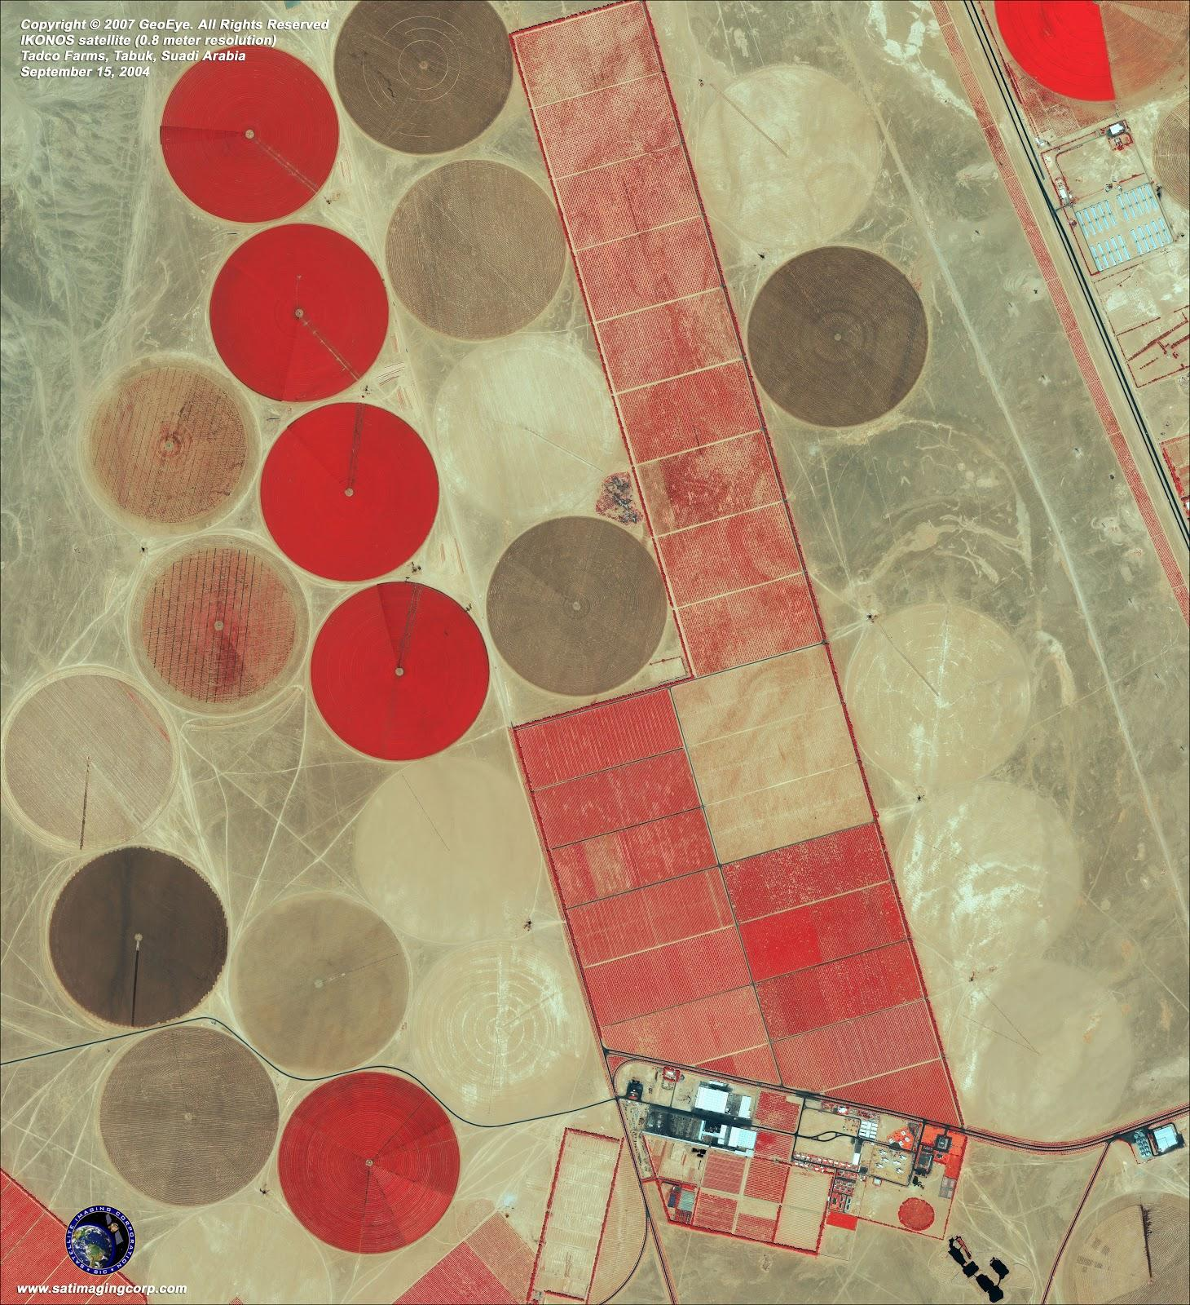
Data Applications
Urban and Rural applications
  Mapping of natural resources and natural disasters
  Agriculture and forestry analysis
  Mining, engineering, construction, and change detection
Military and Homeland Security
  Department of Defense
Tadco farms in Saudi Arabia

Slide 9
Future Use
Continued use for case by case natural disasters and land surveillance

