Slide 1
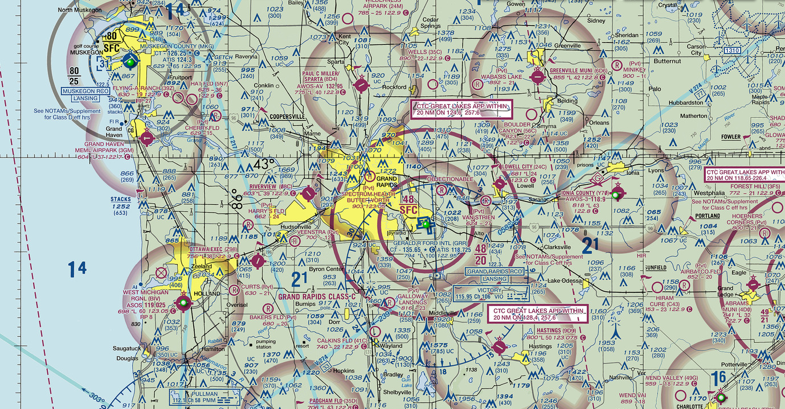

Weather/
Reading Sectional Charts
Understanding airspace and aeronautical maps

Slide 2
UAS operators are REQUIRED to obtain prior authorization before operating in any* controlled airspace
*except for some class E airspaces

Slide 3
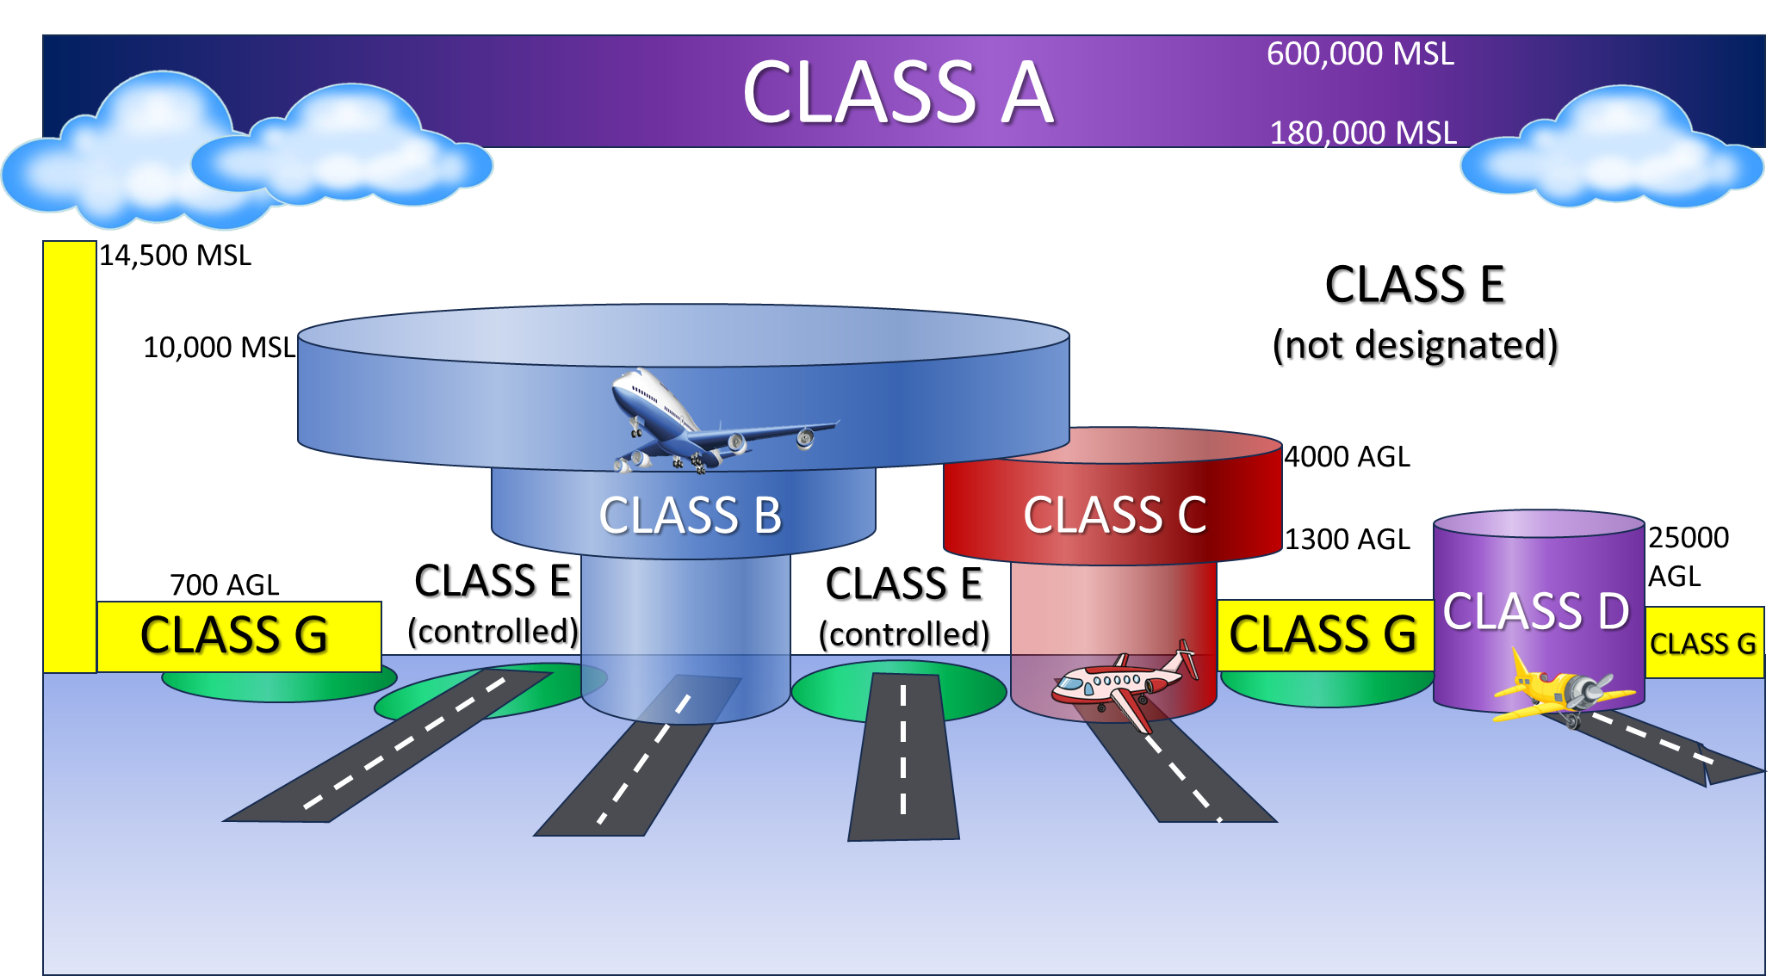

Slide 4
Relevant Acronyms
AGL: Above Ground Level
MSL: Mean Sea Level, elevation above sea level
Source: www.flyeye.io/drone-acronym-agl/

Slide 5


Class A Airspace
FL 180 ft MSL – FL 600 ft MSL

Slide 6
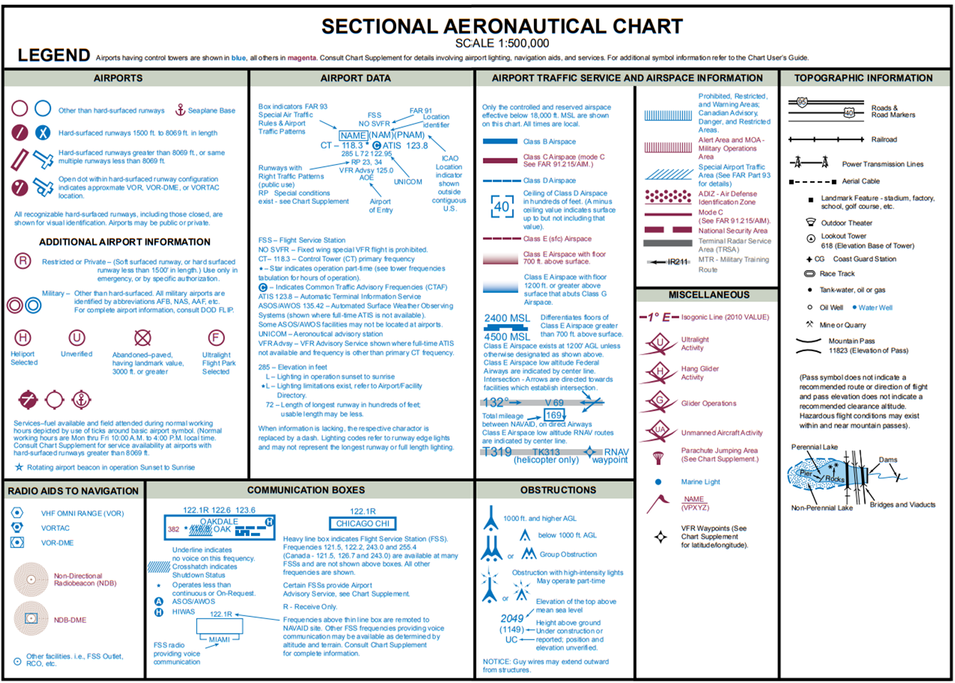

Slide 8
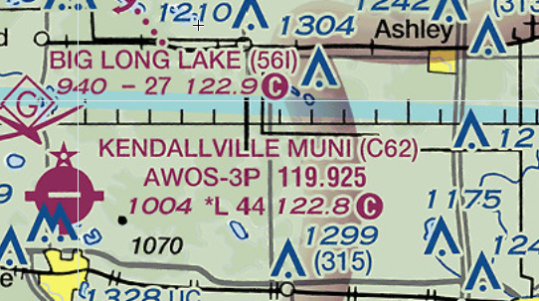
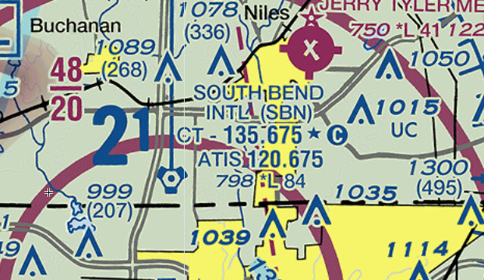
CTAF
Common traffic advisory frequency
ATIS
Automatic terminal information service
AWOS
Automated weather observing information
Elevation
ASOS
Automated surface observing information

Slide 10
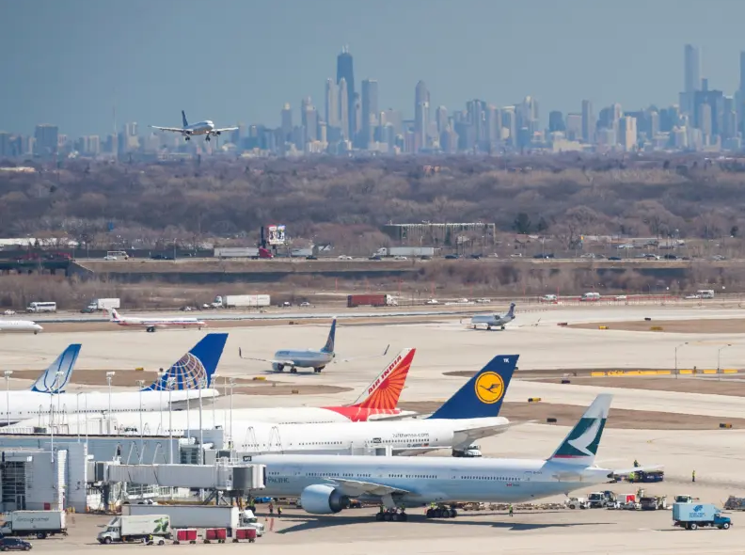
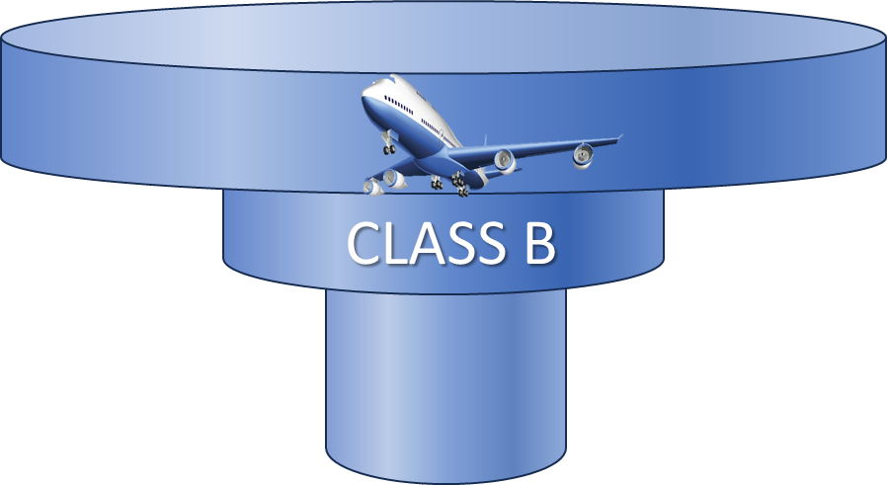
Class B Airspace
SFC– 10,000 MSL
B = BIG
B = BUSY

Slide 11
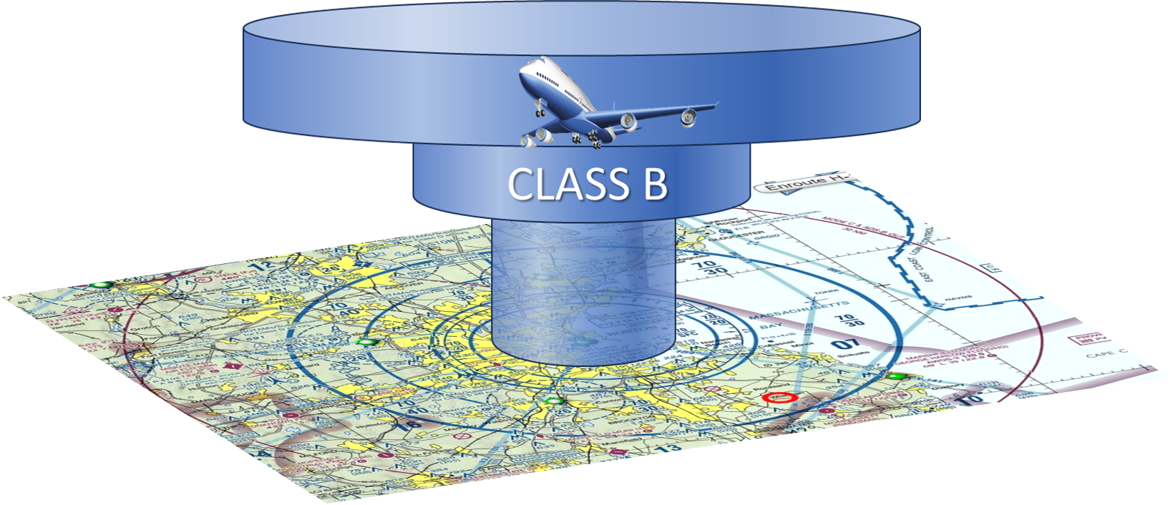
Solid blue lines on a sectional chart

Slide 12
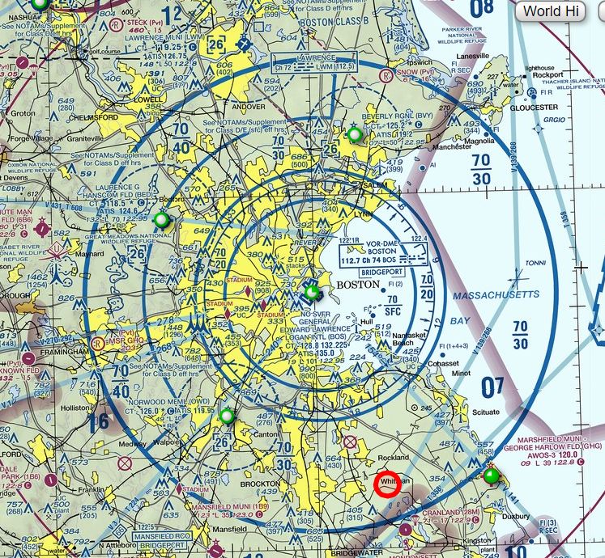
Logan International Airport, Boston, MA

Slide 13
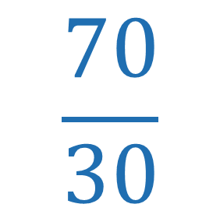

Logan International Airport, Boston, MA
$$\frac{70}{30}$$
$$\frac{70}{SFC}$$
All altitudes are in MSL unless indicated in parentheses
SFC = surface
Add 00 to numbers

Slide 14
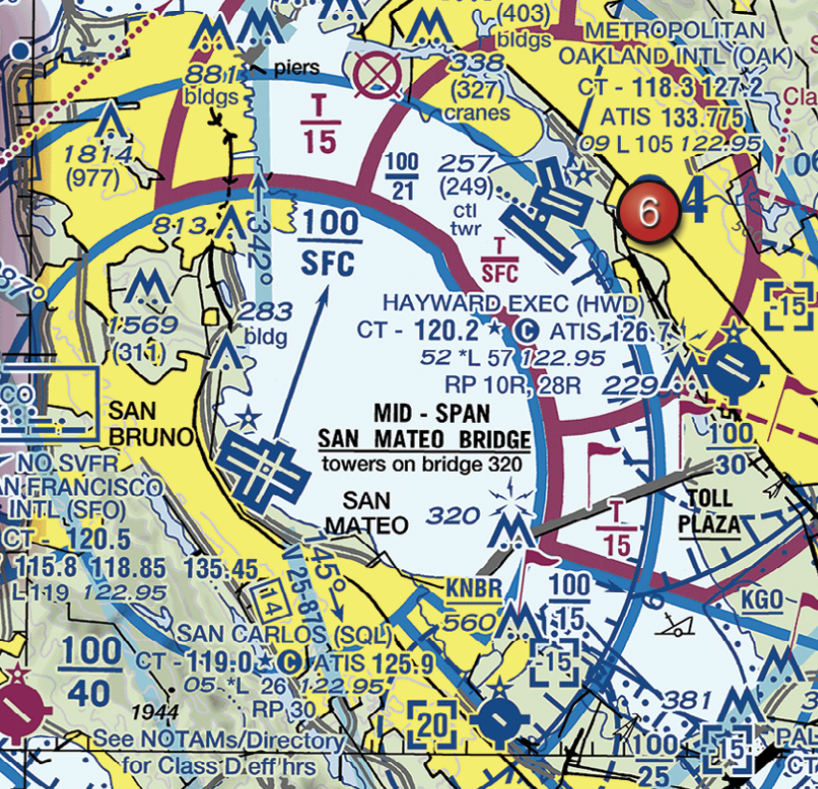
San Francisco International Airport
Would you need prior authorization to fly around this tower?

Slide 15
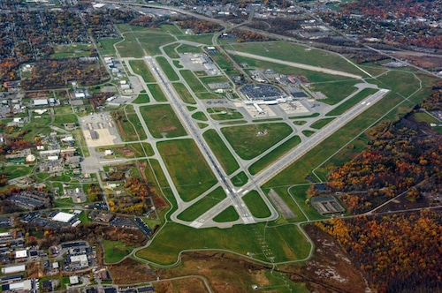

Class C Airspace
SFC– 4,000 AGL
4000 AGL
1300 AGL
5 NM
10 NM

Slide 17
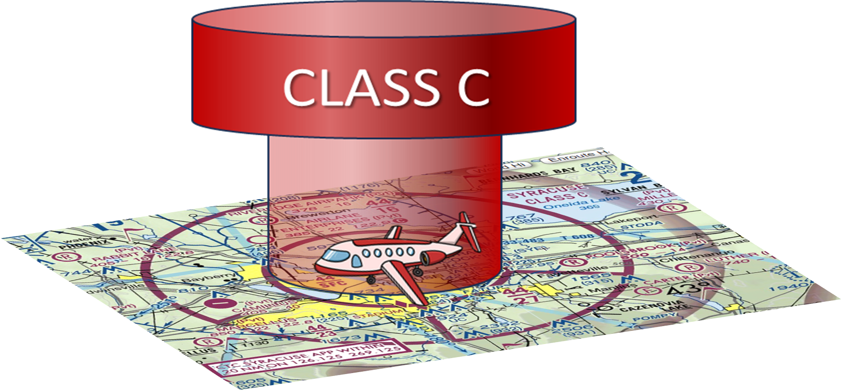
Solid magenta lines on a sectional chart

Slide 18
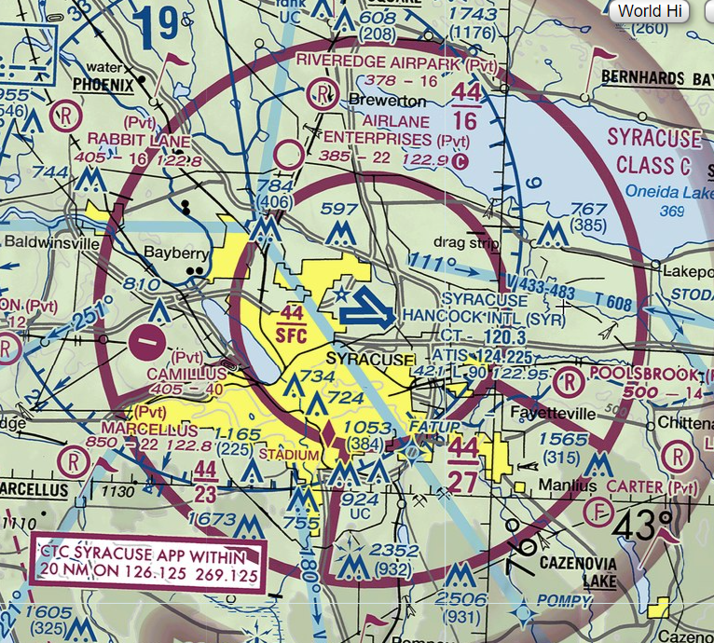


Syracuse Hancock Intl
$$\frac{44}{16}$$
$$\frac{44}{SFC}$$
All altitudes are in MSL unless indicated in parentheses
SFC = surface
Add 00 to numbers

Slide 19
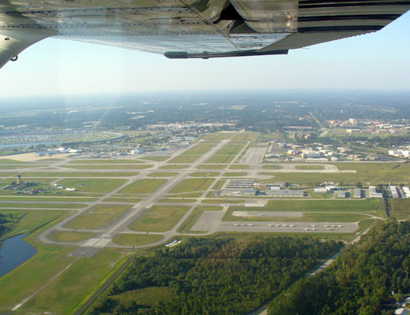

Class D Airspace
SFC– 2,500 AGL

Slide 20
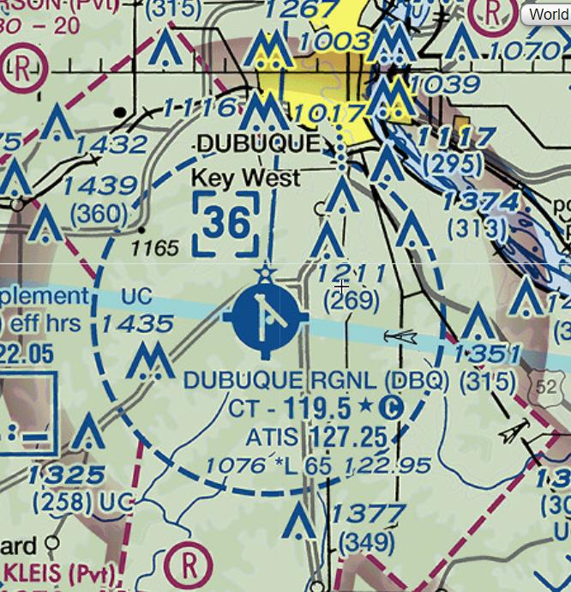

Dubuque Regional Airport, Iowa
36
Airspace ceiling is 3600 ft MSL
Blue-dashed line

Slide 21
Class E Airspace
¹SFC– (designated)
²700+ ft AGL
³1200 ft AGL not designated

Slide 22
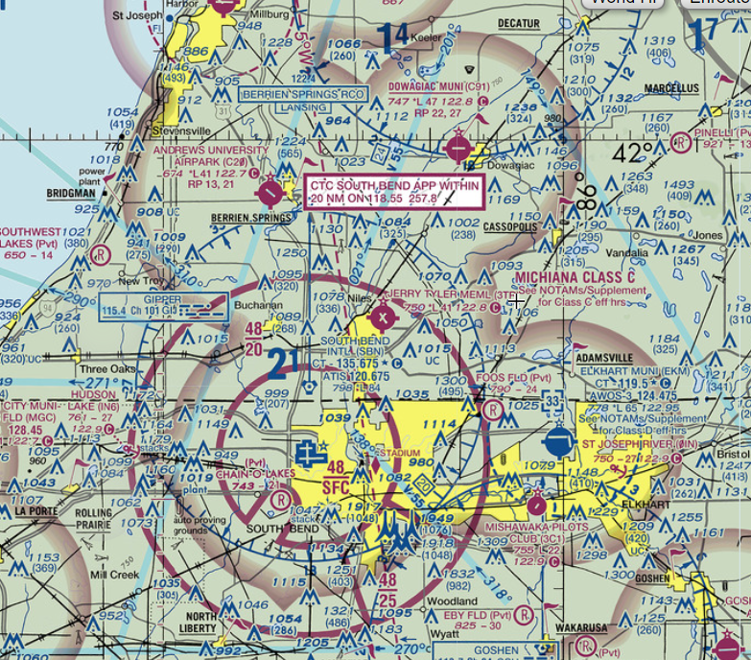
Class E surrounding Class C airspace

Slide 23

Class G Airspace
All uncontrolled airspace up to 1200 AGL
FAA provides no services

Slide 24



$$\frac{41}{16}$$
CLASS C
718’ MSL
400’
318’ MSL

Slide 25
#3
According to 14 CFR part 107 the remote pilot in command of a small unmanned aircraft planning to operate within Class C airspace…
Is required to receive ATC authorization.
Is required to file a flight plan with FAA.
Must use a visual observer.

Slide 26


700 ft AGL
798’ MSL
400’
Class E non-designated
398’ MSL

Slide 27



WEATHER and FLIGHT

Slide 28
The RPIC is REQUIRED to check the weather before flight
SkyVector Flight Planning
Aviation Weather Center

Slide 29
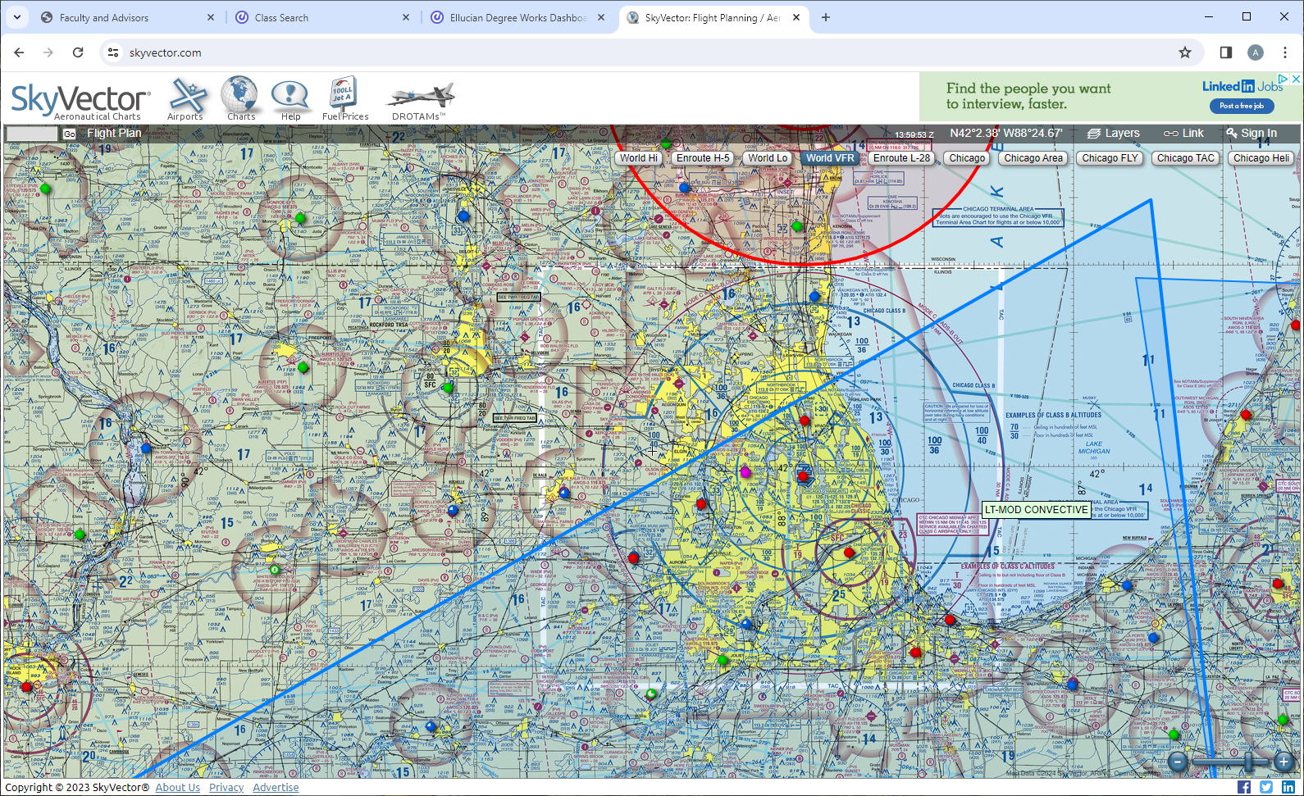
Convective SIGMETs: significant meteorological information. Severe thunderstorm

Slide 30
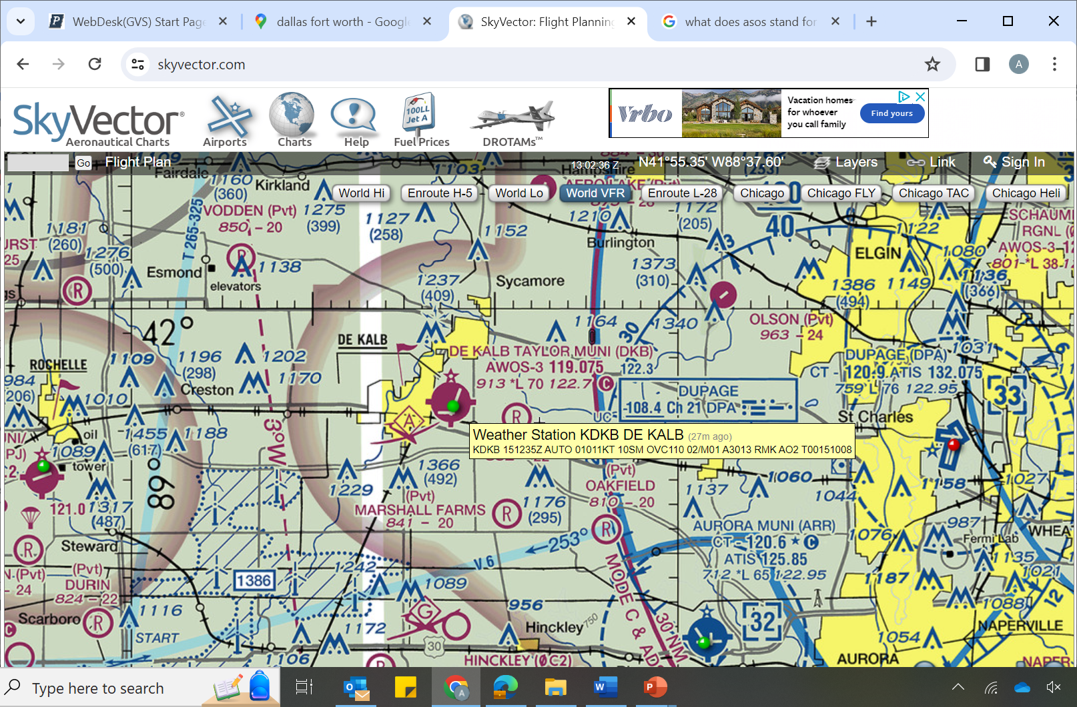
METAR: meteorological aerodrome report

Slide 31
Station location
Automated report
15th day of month
12:35 zulu

Slide 32
Winds coming from 10° TRUE
Speeds of 11 knots
Visibility is 10 statute miles
Overcast with cloud ceiling at 1100 ft AGL

Slide 33
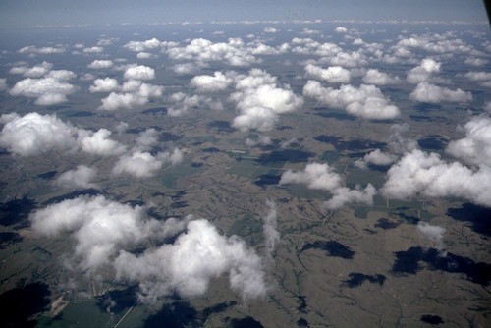


Temperature °C
Dewpoint (M = minus)
Calculate cloud ceiling
$\frac{\text{Temperature}\text{ (°}\text{F}\text{) – }\text{Dewpoint}\text{ (°}\text{F}\text{) }}{4.4}$ * 1000 ft
$\frac{\text{Temperature}\text{ (°}\text{C}\text{) – }\text{Dewpoint}\text{ (°}\text{C}\text{) }}{2.5}$ * 1000 ft

Slide 34


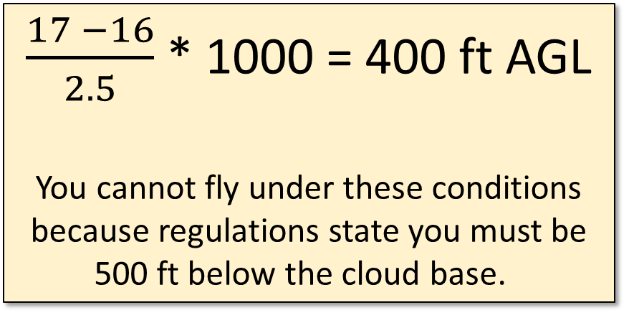
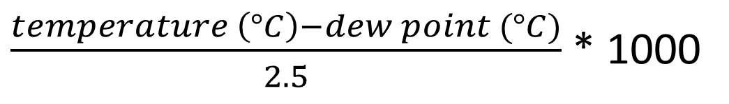
50’
$\frac{temperature \left(°C\right)−dew point (°C)}{2.5}$ * 1000
300’
$\frac{17 −16}{2.5}$ * 1000 = 400 ft AGL
You cannot fly under these conditions because regulations state you must be 500 ft below the cloud base.
50’

