Slide 1

Introduction to Remote Sensing
Electromagnetic radiation principles
Electromagnetic radiation models
Energy interactions in the atmosphere
Energy interactions with Earth surface features

Slide 2
Introduction to Remote Sensing
Energy recorded by remote sensors
A: the energy source or illumination (Electromagnetic radiation)
B: the Earth’s atmosphere
C: the Earth’s surface
D: the sensor
A
D
B
B
C

Slide 3
Introduction to Remote Sensing
Electromagnetic energy/radiation models
Wave model
Particle model

Slide 4
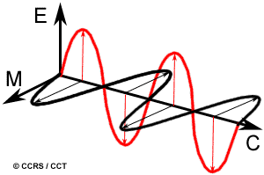
Wave model
Electromagnetic radiation as an electromagnetic wave that travels through space at the speed of light.
The electromagnetic wave consists of an electrical field (E) and a magnetic field (M).
These two fields are orthogonal to one another
Both fields are perpendicular to the direction of travel

Slide 5
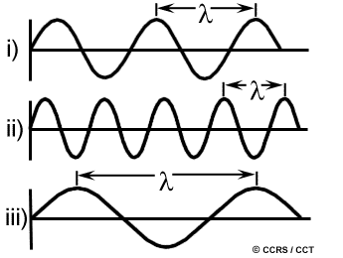
Wave model (continued)
Electromagnetic waves obey the basic equation:
λ= c / v
where
λ = wavelength: the distance from one wave peak to the next (µm)
c = speed of light (3 * 10⁸ m/sec)
υ = frequency of waves: the number of wavelengths that pass a point per unit time (Hz)

Slide 6
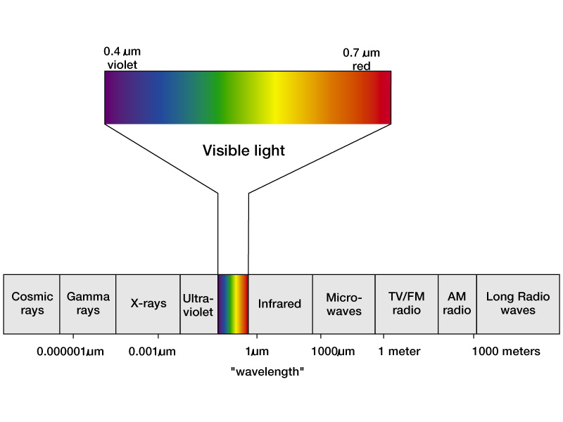
Fig. 4.4--Electromagnetic Spectrum
Source: Hess, D. and McKnight, T. (2014)/ Physical Geography, Chap.4

Slide 7
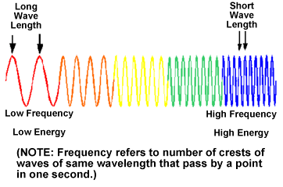
Electromagnetic spectrum
Introduction to Remote Sensing
The Electromagnetic Spectrum is a continuous spectrum of all electromagnetic waves arranged according to frequency and wavelength.

Slide 8
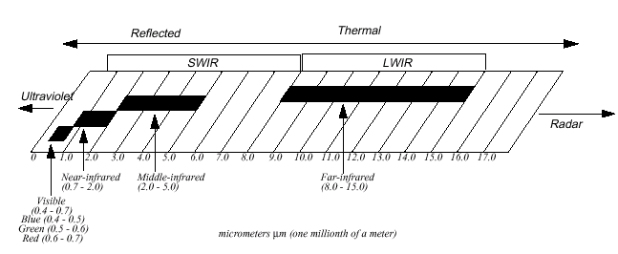
Introduction to Remote Sensing
Electromagnetic spectrum categories
Light is a particular type of electromagnetic radiation that can be seen and sensed by the human eye (0.4 – 0.7 µm).

Slide 9
Particle theory (radiation)
Suggests that EM radiation is composed of many discrete units called Quanta/Photons.
The Energy of a quantum:
where Q = hυ
Q = Energy of quantum in Joules
h = Planck’s Constant (6.626 * 10⁻³⁴ J/sec)
υ = frequency of waves
But
υ = c / λ (from c = υ λ)
Therefore
Q = h c
λ
Therefore, longer wavelength lower energy content
Sensors operating at longer wavelengths must view large areas of the Earth to obtain detectable energy signal.

Slide 10
Stefan-Boltzmann Law (radiation)
All objects at temperatures above absolute zero (-273⁰C or
0 Kelvin (K)) emit EM radiation/energy.
(e.g. the Sun, terrestrial objects)
How much energy an object radiates at certain wavelength is given by Stefan-Boltzmann Law:
M _{λ} = σT⁴
where
M _{λ} = total emitted radiation exiting from the object
(in Watts per square meter)
σ = 5.6697 * 10⁻⁸ W M⁻² K ^{–4}
T = absolute temperature in degrees Kelvin (K)
This law is expressed for an energy source that behaves as a blackbody.
Blackbody: an ideal, hypothetical radiator that totally absorbs and subsequently re-emits (radiates) all energy incident upon it.

Slide 11
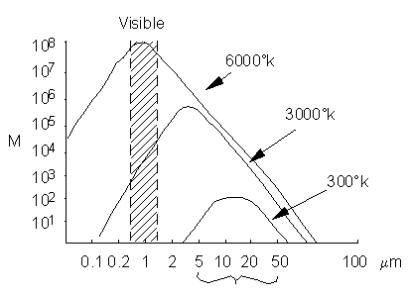
Wien’s Displacement Law
Specifies the relationship between the peak wavelength (dominant wavelength) of emittance and the temperature of an object.
λ _{max} = 2897.8/T
λ max : wavelength of the maximum emittance, (µm)
T: temperature, K
Sun: 0.483 µm
Earth: 9.66 µm
As the temperature of a blackbody gets higher, the wavelength at which the blackbody emits its maximum energy becomes shorter.
Blackbody radiation

Slide 12
Energy interactions in the atmosphere
Irrespective of its source, all radiation detected by remote sensors pass through some distance of atmosphere, or path length, of the atmosphere.
Atmosphere causes:
  Scattering
  Absorption
  Transmission

Slide 13
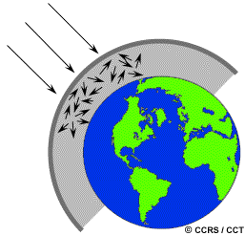
Scattering
Unpredictable diffusion of radiation by particles or large gas molecules in the atmosphere.
Rayleigh Scattering Wavelength >> Particles
Affects shorter wavelengths
The sky appears blue
Video Explanation
https://www.youtube.com/watch?v=4HBuHX4-VU8
Short Summary section: 7:22-9:22
Mie Scattering Wavelength = Particles Influences longer wavelengths
Non-selective Scattering Wavelength << Particles Affects all wavelengths
Clouds appear white (B,R,G equally scattered)

Slide 14
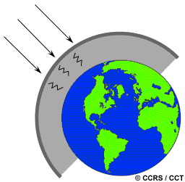
Absorption
Molecules in the atmosphere absorb radiant energy at various wavelengths with different intensity.
Ozone: absorbs the harmful ultraviolet radiation
Carbon dioxide: far infrared region
Water vapour: longwave infrared and shortwave microwave radiation

Slide 15
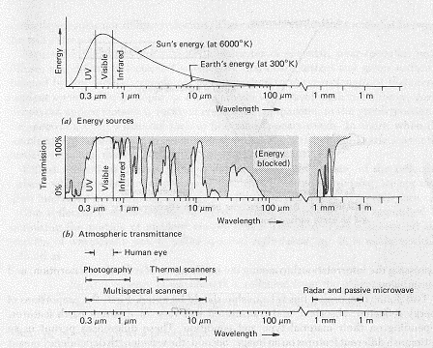
Atmospheric windows
Portions of the spectrum in which atmosphere transmits EM radiation particularly well.
visible,
near-infrared,
middle-infrared,
thermal-infrared, and
microwave

Slide 16
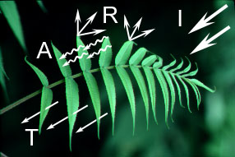
Energy Interactions with Earth’s features
How can plants grow in the SHADE?
Energy incident on a body is reflected, absorbed, or transmitted
absorption: radiation is absorbed into the target
transmission: radiation passes through a target
reflection: radiation “bounces” off the target and is redirected
Proportions of energy reflected, absorbed or transmitted vary for :
different features
different wavelengths

Slide 17
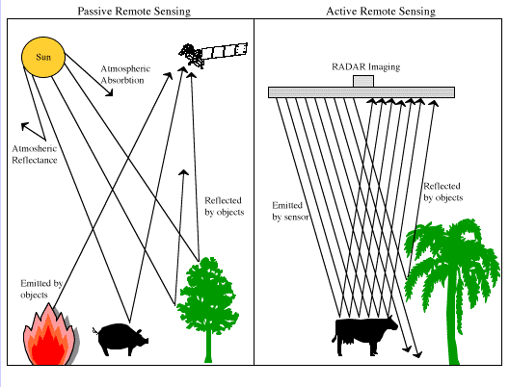
Active and passive remote sensing

Slide 18
Reflected energy
Remote sensing systems depend on reflected energy
spectral reflectance or
reflectance or
spectral signature
Where
=the total amount radiant flux at specific wavelength incident to the Earth’s surface
= the reflected energy
= the transmitted energy
= the absorbed energy

Slide 19
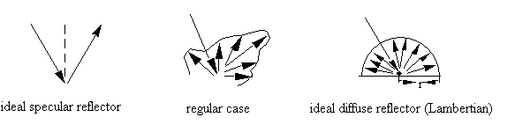
Types of reflections
Specular (mirror-like): angle of incidence = angle of reflection
Example?
Lambertian (diffuse): reflects energy uniformly in all directions
What is an example in the natural world?
Regular case: most bodies behavior between the ideal specular and diffuse reflector

