Slide 1

Types of Remote Sensing Systems (optical)
Introduction to Remote Sensing
Multispectral remote sensing
The collection of reflected, emitted energy from an object or area of interest in multiple bands of the electromagnetic spectrum (Jensen, 2000).
Thermal remote sensing
Data collection only in the thermal portion of the electromagnetic spectrum (in one or more bands).
Hyperspectral remote sensing
Data collection in hundreds of very narrow spectral bands.

Slide 2
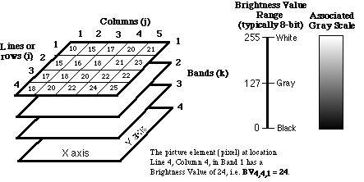
Digital image format
Stored in a raster (matrix, array) format
Each digital value is located at a specific row (i) and column (j) in a matrix.
Dataset consists of n individual multispectral bands.
Brightness values (BR): pixel (picture element) values
8-bit: 0-255; 10-bit: 0-1023; and 12-bit: 0-4095
quantization level of the sensor systems

Slide 3
Multispectral remote sensing systems
Multispectral remote sensing systems sense the electromagnetic range from 0.4 to 14 µm using
  discrete detectors and scanning mirrors (across track)
  Landsat MSS, Landsat TM, Landsat ETM⁺
  linear arrays (along track)
  SPOT HRV, SPOT HRVI, IRS LISS, IKONOS, Quickbird

Slide 4
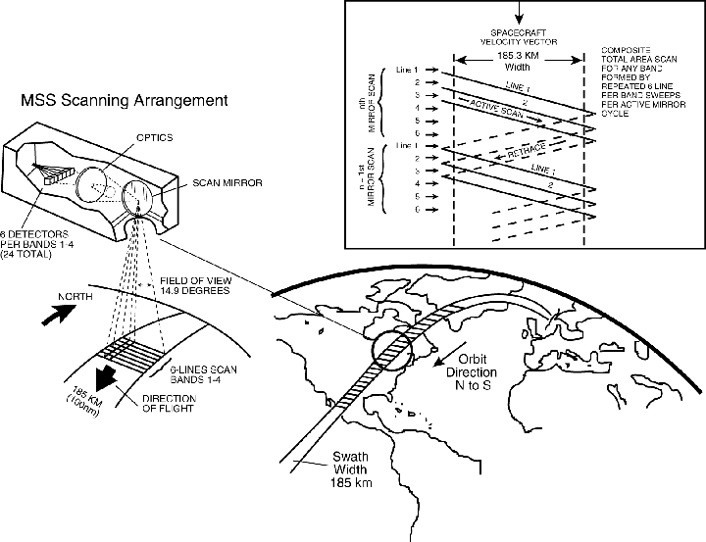
Multispectral imaging using
discrete detectors and scanning mirrors
Differences between this system and a camera system
discrete electronic detectors
a rotating mirror is added in front of the lens of camera
films are changed to photo-sensitive detectors and magnetic tapes

Slide 5
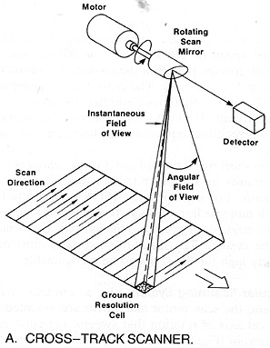
Across track
Across-track scanners scan the Earth in a series of lines. The lines are oriented perpendicular to the direction of motion of the sensor platform (i.e. across the swath).

Slide 6
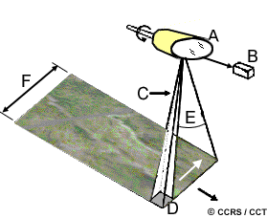
Across track
IFOV (C) (instantaneous field of view): the angle within which incident energy is focused on the detector.
Field of view (E): the sweep of the mirror, used to record a scan line.
Swath width (F): determined by the field of view and altitude of the platform
A: rotating mirror
B: detector
D: spatial resolution

Slide 7
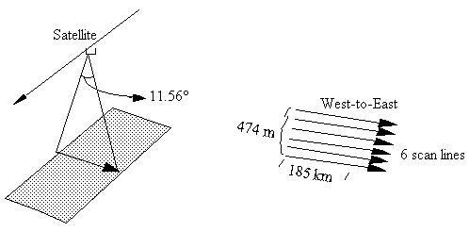
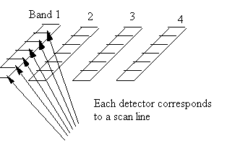
Multispectral Scanning System (MSS)
Introduction to Remote Sensing
Across –track of the scanning
Along –track of the satellite
swath width
Each scan will collect six image lines.
Each scene covers: 185 km X 170 km
a spatial resolution: 79 m X 57 m
Six detectors per band (24 detectors total).

Slide 8
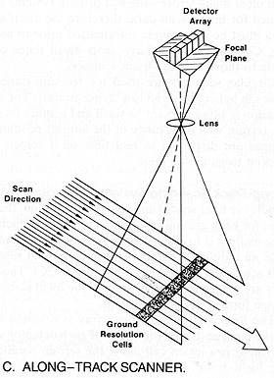
Along track
Along-track: detectors record data along a swath which is perpendicular to the flight line.
Notes:
The sensor images a complete line of the ground scene in one look.
A line (a swath) on the earth surface is recorded within one snapshot.

Slide 9
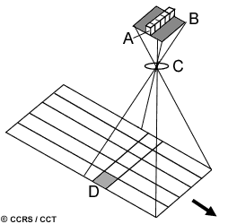
Along track
uses a linear array detectors (A)
detectors are push along in the flight track direction (along track)
referred to as pushbroom scanner
each individual detector measures the energy for a single ground resolution cell (D).
B: focal plane
C: lens
Notes:
The sensor images a complete line of the ground scene in one look.
A line (a swath) on the earth surface is recorded within one snapshot.

Slide 10
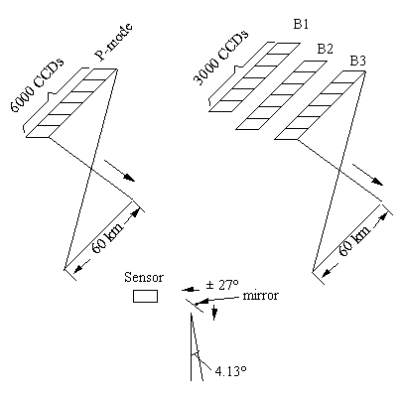
Multispectral imaging using linear arrays
(pushbroom, SPOT HRV)
Introduction to Remote Sensing
Use thousands of detectors arranged linearly called "charge-coupled devices" (CCDs) instead of a few detectors used by MSS and TM
panchromatic (PAN) mode
multispectral (XS) mode
This sensor images a complete line of the ground scene in the cross-track direction in one look.
  A mirror with the view angle of 4.13° is used to allow ±27° off nadir (oblique) observation, allows acquisitions of stereo-pair images more frequently (3-5 days)

Slide 11
Comparison of a linear sensor and a scanning sensor
Introduction to Remote Sensing
A linear sensor is superior than a scanning sensor
A more accurate measurement from CCDs
  no moving mirror, no mechanical scanning, hence are more reliable and have a longer life
  dwell longer on a specific portion of the terrain, --stronger signals can be recorded
CCDs are smaller in size and weight, and require less power than across track scanners
A disadvantage ?
Disadvantage: of a linear sensor is the difficulties involved in calibrating thousands of detectors.

Slide 12

Satellite orbits
Orbit is the path followed by a satellite.
Orbit elements
  altitude
  period
  cycle
  inclination

Slide 13
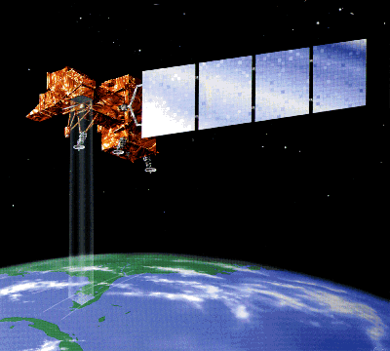
Altitude
  Height of the platform above the earth’s surface.
  Landsat 7 is in orbit at 705 km (420 mi) above the earth.
Source: http://www.sci-ctr.edu.sg/ssc/publication/remotesense/landsat.htm

Slide 14
Period
  The time of a satellite to complete one orbit.
  Landsat 7 orbits of the earth once every 99 min, resulting in 14.5 orbits per day.
Jensen, 2000

Slide 15
Orbit cycle
The length of time needed for the satellite to retrace its path.??
e.g. 16 days
i.e. passing over the same point on the Earth's surface directly below the satellite (called the nadir point) for a second time.
Varies with each satellite
June 1, 1999
June 17, 1999
July 3, 1999
The temporal resolution is every 16 days.

Slide 16
Inclination
Refers to the angle at which a satellite crosses the equator.
near-polar orbits with an inclination close to 90⁰ Example?
Landsat 7
geostationary orbits with an inclination of 0⁰, example?
GOES Weather satellites

Slide 17
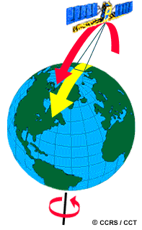
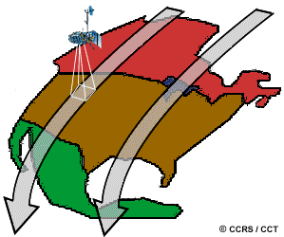
Near-polar orbits
  Most of the RS satellite platforms
  basically N-S orbit (constant E-W position)
  + the Earth's W-E rotation
  allow complete coverage of the Earth's surface after one complete cycle of orbits
  https://www.youtube.com/watch?v=P-lbujsVa2M
  Source: NASA

Slide 18
Near-polar orbits
  Sun-synchronous
  The orbital plane processes around the Earth at the same angular rate at which Earth moves around the Sun
  This characteristic causes the satellites to cross the equator at the same local time (9:30-10:00 am) on the illuminated side of Earth.

Slide 19
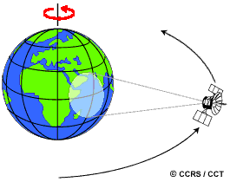
Geostationary orbits
  Satellites at very high altitudes (ca. 36,000 km)
  Revolve at speeds that match the rotation of the Earth (→ seem stationary)
  Examples?
  E.g. weather & communications satellites
  Collect info over the same portion of the earth's surface at all times
  https://www.youtube.com/watch?v=FsfcIEmR_b0

Slide 20
Landsat series satellites
Initiated by NASA (The National Aeronautics and Space Administration ), encouraged by the U.S. Department of Interior in 1967
The first of the Landsat series was launched in 1972.
  called Earth Resources Technology Satellites (ERTS-1)
  renamed as Landsat 1 later
Landsat 2 was launched in 1975 (ERTS-B)
Landsat 3 had a short life, and launched in 1978.
Landsat 4: launched in 1982
Landsat 5: launched in 1984
Landsat 6: launched unsuccessfully in 1993
Landsat 7: launched in April 15, 1999
  NASA and USGS currently share the responsibility of Landsat 7 operations, data processing, archive and distribution.
Notes:
Only Landsat 7 and 5 are still working.

Slide 21
Landsat series satellites
Landsat 8: The latest was launched
February 11, 2013
Landsat 8 is offset 12 hours from Landsat 7
Landsat 9, Launch: Sept. 27, 2021
https://landsat.gsfc.nasa.gov/satellites/landsat-9/
Notes:
Only Landsat 8 launched 2/11/2013.

Slide 22

Landsat series satellites
Source: https://landsat.gsfc.nasa.gov/satellites/landsat-9/
Notes:
Only Landsat 8 launched 2/11/2013.

Slide 23
Landsat circular orbits (1-3)
  Orbits around Earth at an altitude of 919 km (Landsat 1 to 3)
  Had an orbital inclination of 99⁰, nearly polar
  orbits Earth once every 103 min, 14 orbits per day
  Sun-synchronous orbit
  Revisit rate: 18 days (Landsat 1 to 3)

Slide 24
MSS parameters
MSSs have been used on Landsat - 1, 2, 3, 4, 5.
Landsat 1, 2 |  | Landsat 4, 5
B4 | 0.5 - 0.6 µm | B1
B5 | 0.6 - 0.7µm | B2
B6 | 0.7 - 0.8 µm | B3
B7 | 0.8 - 9.1 µm | B4
Each scene: covers 185 km X 170 km
a spatial resolution of 79 m X 57 m
instantaneous field of view (IFOV) of 79 m X 79 m

Slide 25
Major changes of Landsat Thematic Mapper (TM)
as compared to the MSS (Landsat 4 and 5)
Increased the number of spectral bands
Improved spatial and spectral resolution
Orbit changed from a 919-km to a 705-km, influence?
Increased the angle of view from 11.56° to 14.92°
Repetitive rate changed from 18 to 16 days
16 detectors are used to collect the data for B1-B5, B7
4 detectors are used to collect the thermal data
Blue | TM1 | 0.45 - 0.52 µm | 30 m
Green | TM2 | 0.52 - 0.60 | 30 m
Red | TM3 | 0.63 - 0.69 | 30 m
Near IR | TM4 | 0.76 - 0.90 | 30 m
SWIR | TM5 | 1.55 - 1.75 | 30 m
SWIR | TM7 | 2.08 - 2.35 | 30 m
Thermal IR | TM6 | 10.4 - 12.5 µm | 120m
Notes:
Both resolution improvements, plus the fact that the green and red bands are narrower make it better for vegetation discrimination than MSS; also near IR in TM is narrower and centered in a region that is highly sensitive to plant vigor.

Slide 26
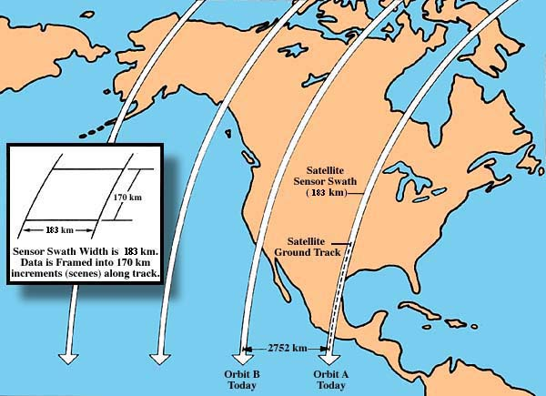
Landsat
Swath is 183 km wide
233 orbits, for each 16 day cycle

Slide 27
Major changes of
Landsat Enhanced Thematic Mapper Plus
(ETM⁺) as compared to the TM
Introduction to Remote Sensing
The addition of the new panchromatic band
Improved spatial resolution with the Thermal infrared band 6
TM1 | 0.45 - 0.52 µm | 30 m
TM2 | 0.52 - 0.60 | 30 m
TM3 | 0.63 - 0.69 | 30 m
TM4 | 0.76 - 0.90 | 30 m
TM5 | 1.55 - 1.75 | 30 m
TM7 | 2.08 - 2.35 | 30 m
TM6 | 10.4 - 12.5 | 60 m
PAN | 0.52 - 0.90 | 15 m

Slide 28
Landsat 7 circular orbits
Orbits around Earth at an altitude of 705 km
8 degrees off a polar orbit, nearly polar
One orbit takes about 99 minutes (14.5 per day)
Sun-synchronous orbit
  by following earth’s rotation with each pass, it can keep crossing the equator at the same time
  always crosses equator at around 10 AM.
The repeat cycle is 16 days
Distance between ground tracks of consecutive orbits is 2,752 km at equator because of the earth’s rotation

Slide 29
Landsat 7 ETM+
Spectral and spatial resolution of bands
Band wavelength spectrums are slightly different from LANDSAT 5

Slide 30
Landsat band properties
1 =Blue, 0.45-0.52 µm
mapping coastal water areas, differentiating between soil and vegetation, forest type mapping, and detecting cultural features.
2 =Green, 0.52-0.60 µm
Vegetation identification and assessment of vigor, cultural feature identification.
3 =Red, 0.63-0.69 µm
discriminating between many plant species; determining soil boundary and geological boundary delineations as well as cultural features.
4 =Reflective-infrared, 0.76-0.90 µm
This band is especially responsive to the amount of vegetation biomass present in a scene;
crop identification and emphasizes soil/crop and land/water contrasts.
5 =Mid-infrared, 1.55-1.75 µm
This band is sensitive to the amount of water in plants; crop drought studies and in plant health analyses; discriminate between clouds, snow, and ice.
6 =Thermal-infrared, 10.40-12.50 µm
This band is useful for vegetation and crop stress detection, heat intensity, insecticide applications, and for locating thermal pollution. locating geothermal activity.
7 =Mid-infrared, 2.08-2.35 µm
for the discrimination of geologic rock type and soil
boundaries, as well as soil and vegetation moisture content.

Slide 31
Landsat band properties
Band | Nominal Spectral location | applications
1 | Blue | Water body penetration, soil-water discrimination, forest type mapping, cultural feature ID
2 | Green | Green reflectance peak of veg, for veg ID and assessment of vigor, cultural feature ID
3 | Red | Chlorophyll absorption region, plant species differentiation, cultural feature ID
4 | Near infra red | Veg types, vigor and biomass content, dilineating water bodies, soil moisture assessment
5 | mid infra red (1.55-1.75 mm) | Veg moisture, soil moisture, diff of soil from clouds
6 | Thermal infra red | Veg stress analysis, soil moisture, thermal mapping
7 | mid infra red(2.08-2.35 mm) | Discriminating mineral and rock types, veg moisture

Slide 32
Landsat 9 with OLI, and Thermal Infrared (TIRS-2)
Spectral and spatial resolution of bands
Sept. 27, 2021 Launch, see link:
https://geonarrative.usgs.gov/landsat-9-road-to-launch/
Landsat Science
Band wavelength spectrums are slightly different from LANDSAT 5

Slide 33
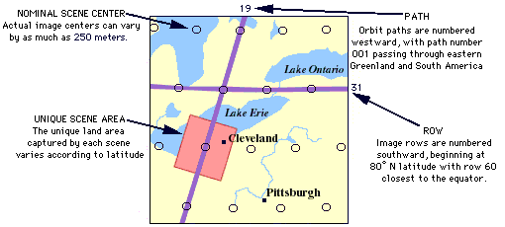
Landsat scene
Scenes are then indexed by the path and a row

Slide 34
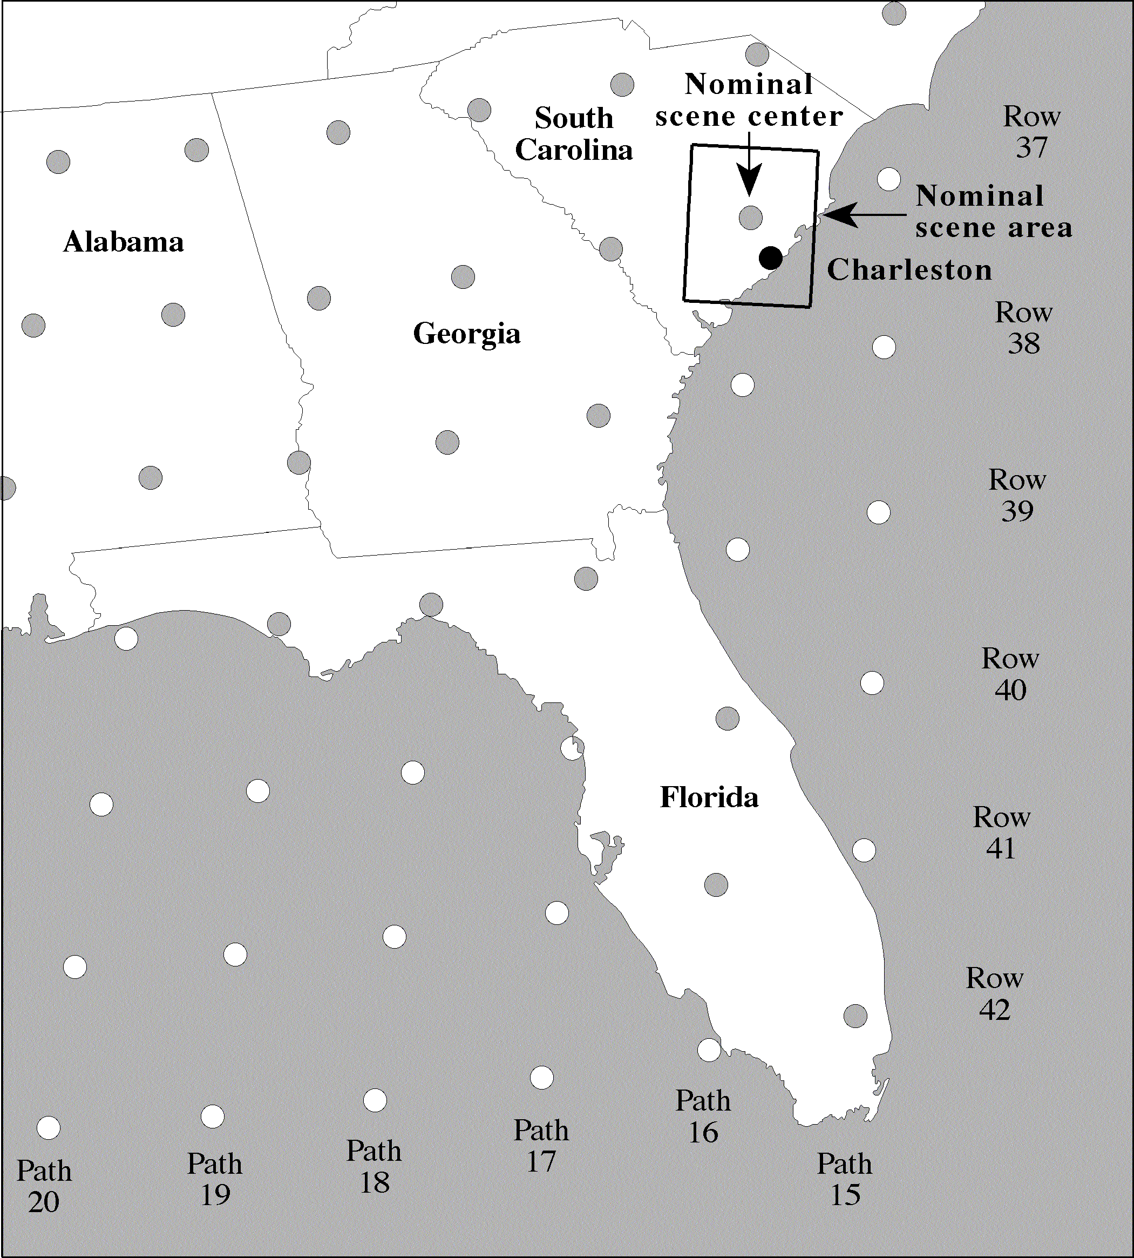
Landsat 4 and 5 Worldwide Reference System
Jensen, 2000

Slide 35
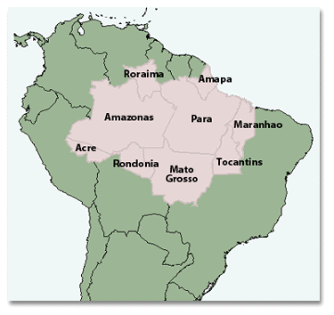
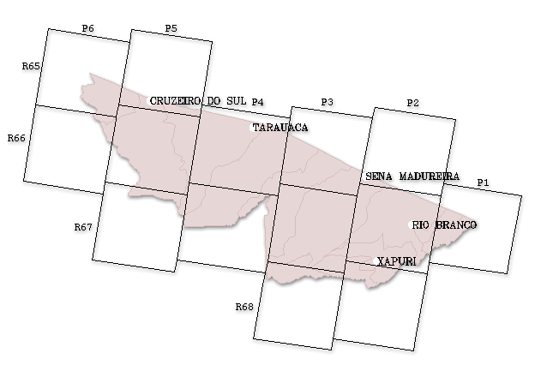
Brazilian Amazon Case Study Area
Rio Branco, Acre State, Brazil
Fig. 2.-Landsat Thematic Mapper
World Referencing System II
(WRS II), Path 2, Row 67
Fig. 1.-Legal Amazon of Brazil
Source: Basic Science and RemoteSensing Initiative,
Michigan State U. (http://bsrsi.msu.edu/trfic/browser/legalamazon_frame.html)
Brazil

Slide 36
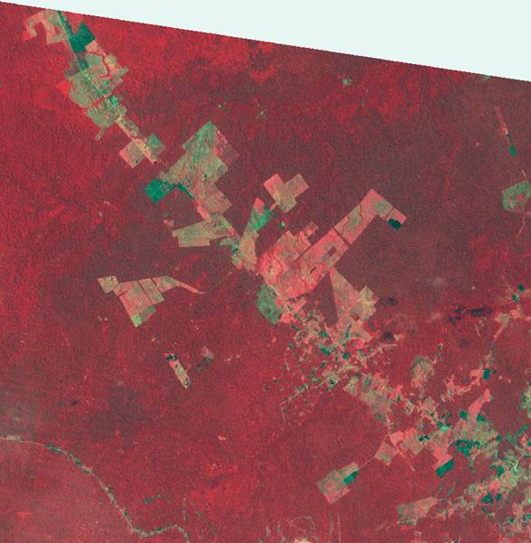
Rio Branco and BR 364 Highway, Acre State, Brazil
NW Section processed
Fig. 4. - Landsat TM Color Infrared
image, Path 2, Row 67, 8/30/1992
Forest Spectral Sig.
Deforested Spectral Sig.
2nd Growth Spectral Sig.
BR 364 Highway
Rio Branco

Slide 37
Landsat product
All data older than 2 years return to "public domain" and are distributed by the Earth Resource Observation System (EROS) Data Center of the US Geological Survey
Available at
http://earthexplorer.usgs.gov
The LANDSAT Reference system catalogues the world into 57,784 scenes, each 115 miles (183 kilometers) wide by 106 miles (170 kilometers) long.

Slide 38
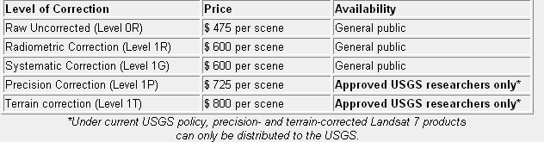
Landsat product (USGS)
  OR: no radiometric or geometric correction applied. Scan lines are reversed and nominally aligned.
  1R: includes radiometric correction, but no geometric correction. Scan lines are reversed and nominally aligned.
  1G: includes both radiometric and geometric correction. The scene will be rotated, aligned, and georeferenced to a user-defined map projection.

Slide 39
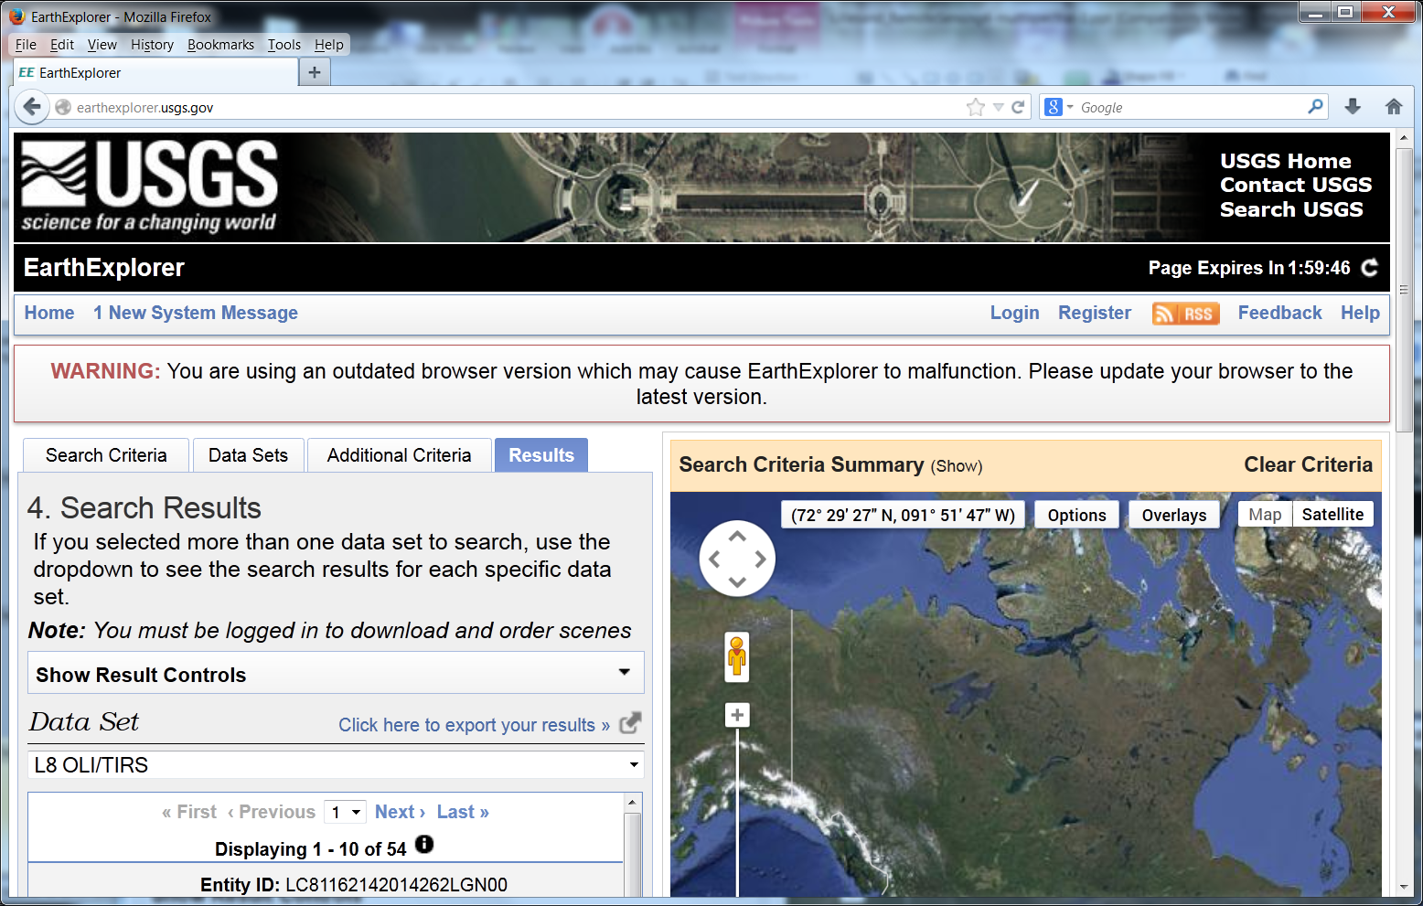
Landsat products
http://earthexplorer.usgs.gov
  They have a browser for finding and ordering Landsat imagery these and a variety of other RS images

Slide 40
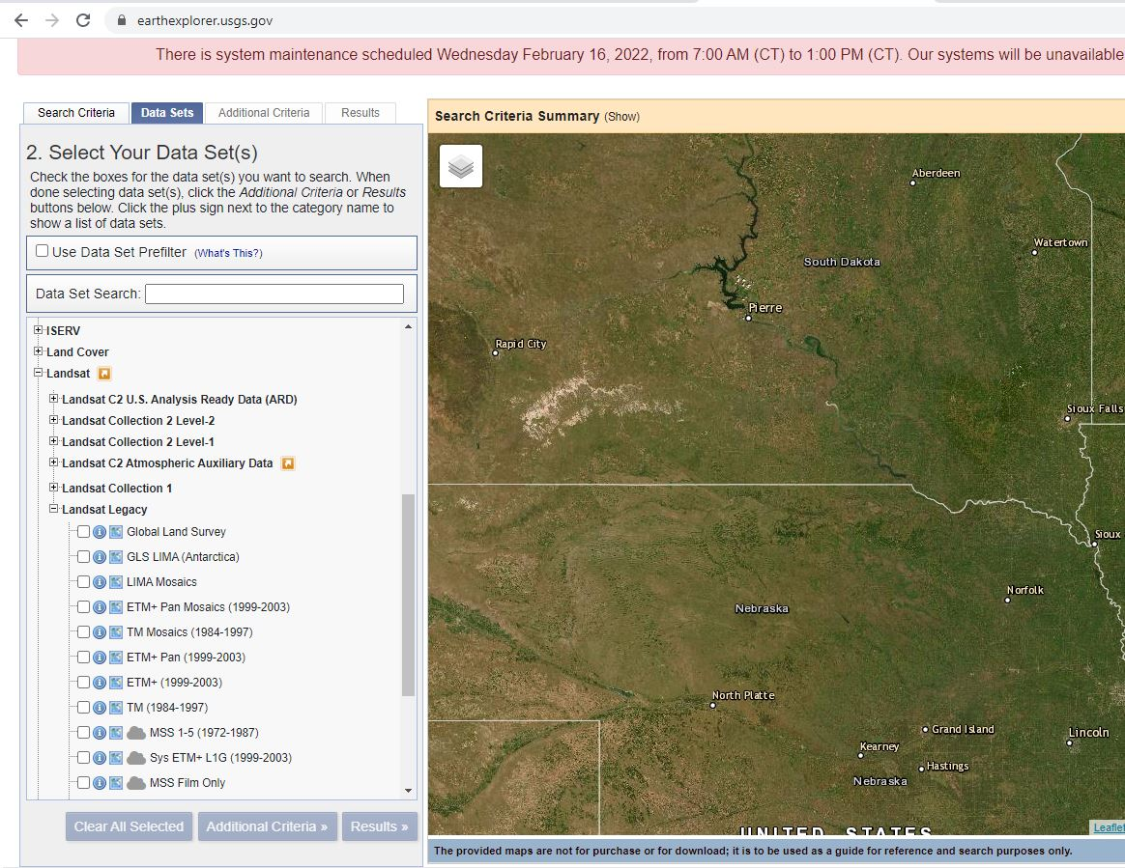
Landsat products
Downloading Imagery, https://www.youtube.com/watch?v=Wn_G4fvitV8

