Slide 1

Objectives
Introduction to Remote Sensing
Terminology of aerial photographs
Displaying multispectral images

Slide 2
Terminology of aerial Photographs
Introduction to Remote Sensing
Vantage point
Flight height
Scale
View angle
Ground coverage

Slide 3
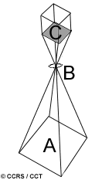
Camera systems
Camera systems are passive optical sensors that
  use a lens (B)
  to acquire a snapshot of an area (A), and
  to form an image at the focal plane C.

Slide 4
Vantage point
Vantage point = Camera orientation
The orientation of the camera relative to the ground during acquisition.
  vertical
  oblique

Slide 5
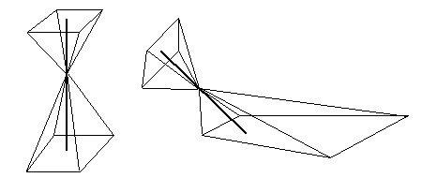
Vertical aerial photography
A vertical photograph is obtained when the camera’s optical axis is within 3° of being vertical to the Earth surface.
optical axis
less distortion
Used to create planimetric, topographic, and orthophotomaps, and DEMs using fundamental photogrammetric principles.

Slide 6
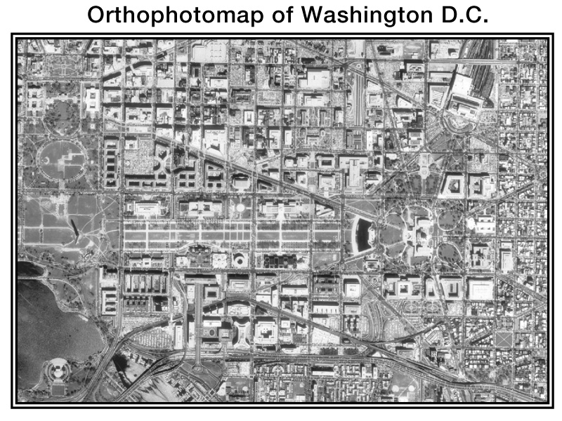

Slide 7
Oblique aerial photography
An oblique aerial photograph is obtained if the camera’s optical axis deviates more than 3° from vertical.
optical axis
more distortion
Useful for covering very large areas in a single image and for depicting terrain relief and scale.

Slide 8
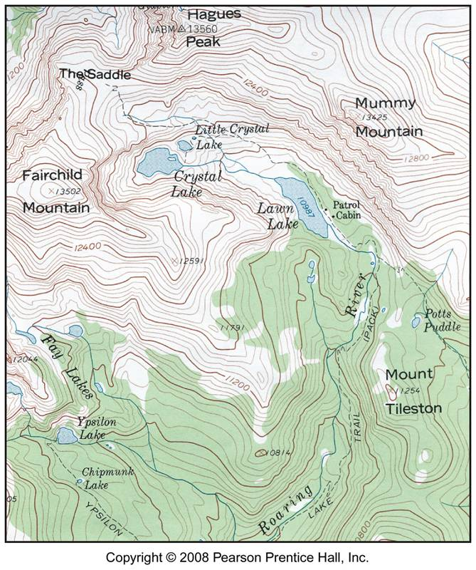

Slide 10
Flight Height (Altitude)
Altitude of the camera above ground level (AGL), for a given focal length
  the higher the altitude, the larger the area
  the lower the altitude, the smaller the area
f
H1
H2

Slide 11
Scale
Photo Scale (S) = Distance on Photograph
Distance on the ground
For an aerial photograph, scale is:
S = camera focal length (f)
flying height above terrain(H)
Scale can be denoted as
Verbal scale: 1 cm equals 1 km
Representative fraction: 1/100,000, or Ratio scale:1:100,000
Graphic (bar) scale:
4
0
0
4
0
8
0
M
i
l
e
s

Slide 12
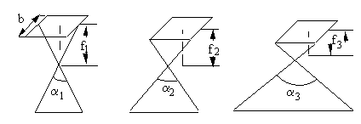
View Angle
The field of view of a camera
f1 > f2 > f3
a1 < a2 < a3
Giving the same flight height, viewing angle is determined by the focal length.
The smaller the focal length, the larger the view angle

Slide 13
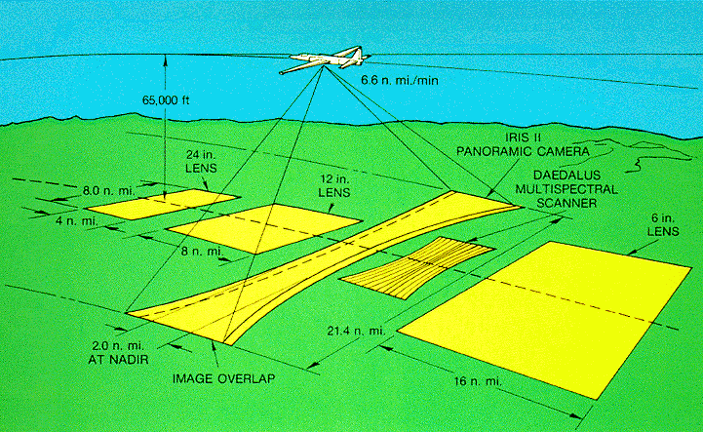
Ground Coverage
The actual area on the ground that one air photograph covers. Determined by the altitude and the camera’s viewing angle.

Slide 14
The advantage and disadvantage of aerial photography (film)
Introduction to Remote Sensing
Advantages:
High resolution (ground)
Flexibility
High geometric reliability
Relatively inexpensive
Disadvantages:
Day light exposure (10:00 am- 2:00 pm) required
Poorer contrast at shorter wavelengths
Film non-reusable
Inconvenient
Inefficient for digital analysis

Slide 15
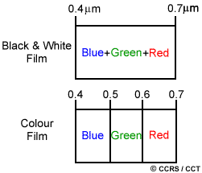
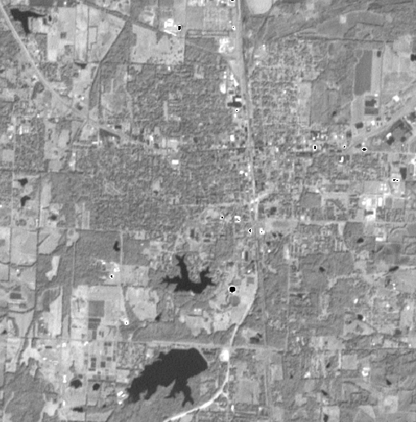
Panchromatic imaging
With panchromatic imaging, the sensor is a single channel detector sensitive to radiation in a broad wavelength range.
Where the wavelength range coincides with the visible range, the resulting image resembles a "black-and-white" photograph.

Slide 16
Multispectral Imaging
With multispectral, or multiband data, there are several layers, or values for each pixel, each representing a different “channel/band” or reflectance in a wavelength spectrum.
Each “band” or “channel” is sensitive to radiation within a different band of wavelength, through use of different filters.

Slide 17
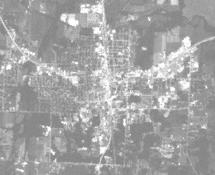
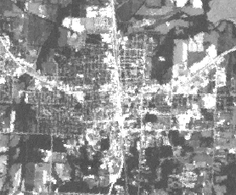
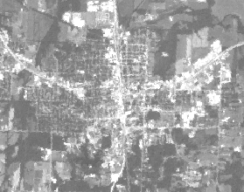
Displaying multispectral bands separately
These bands can be looked at separately.
One band from a multispectral image would be displayed as a grayscale image, with each pixel represented by a grayscale value.
blue
green
red

Slide 18
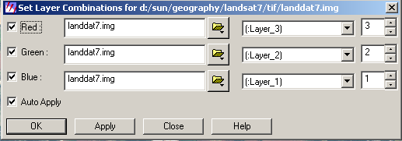
Displaying multispectral bands (2)
These bands can be combined to make “composite” images.
Composite images are usually displayed by assigning three of the bands to the red, green and blue channels and displaying them additively.

Slide 19
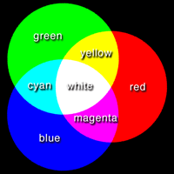
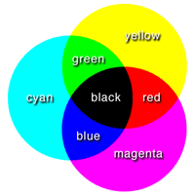
Color types
additive primaries: red, green, and blue
subtractive primaries: cyan, magenta, and yellow
Light mixing follows this
Dye mixing follows this
Additive and subtractive colors
Blue+Green+Red = White Yellow+Magenta+Cyan = Black
Displaying image is based on additive mixing of primary colors, whereas color photography is based on subtractive mixing of complementary colors.

Slide 20
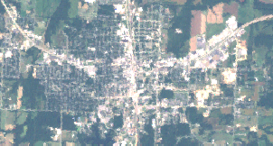
True color composite
Bands are assigned to color channels in such a way that colors in the image roughly correspond with the colors in the real world. Often assigned red to red, green to green and blue to blue can result in this.
Band Composite Output =
Color Guns =
Band Combination =
3
2
1 (LANDSAT)
BLUE
GREEN
RED
SHORT
WAVE IR
MID-
WAVE IR
NEAR IR
LONGWAVE IR
Landsat TM Band
1
2
3
4
5
7
6

Slide 21
False color composite
Shows colors that don’t really exist in that location. An example is color infrared composite, where green band is assigned to blue display channel, red is assigned to green and Near IR is assigned to red.
Band Combination =
4
3
2 (LANDSAT)
BLUE
GREEN
RED
NEAR IR
SHORT
WAVE IR
MID-
WAVE IR
LONGWAVE IR
Landsat TM Band
1
2
3
4
5
7
6

Slide 22
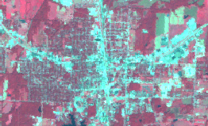
False color composite
Band Composite Output =
Color Guns =
Band Combination =
4
3
2 (LANDSAT)
BLUE
GREEN
RED
NEAR IR
SHORT
WAVE IR
MID-
WAVE IR
LONGWAVE IR
Landsat TM Band
1
2
3
4
5
7
6

