Slide 1
Remote Sensing of Vegetation
Notes:
2
Good morning everybody.
Let’s get started.
Last week we talked about the course syllabus.
The purpose of last week’s lecture was to give you an overview of the course.
Today we are going to look at a couple of important/basic things about RS technology.

Slide 2

Lecture objectives
Phenological cycle
Vegetation indices
  Vegetation index (VI)
  Normalized difference vegetation index (NDVI)
  Enhanced vegetation index (EVI)

Slide 3
Vegetation Indices
Topics:
  What are Vegetation Indices?
  Why do they work?
  Band Ratios
  emphasize leaf area index (LAI), % green cover, chlorophyll content, green biomass.
  NDVI: Normalized Difference Vegetation Index
  EVI: Enhanced Vegetation Index

Slide 4
Phenological cycle characteristics
What is phenology?
periodic biological phenomena that are correlated with climatic (annual) conditions
Tells when Remote Sensing (RS) data should be collected
When the crops are planted?
When they are harvested?
When do they reach their full development?
And when they have not yet developed.

Slide 5
Phenological cycle characteristics

Slide 6
Phenological Cycles of Soybeans and Corn in South Carolina
Soybeans
Corn
Jensen, 2000

Slide 7
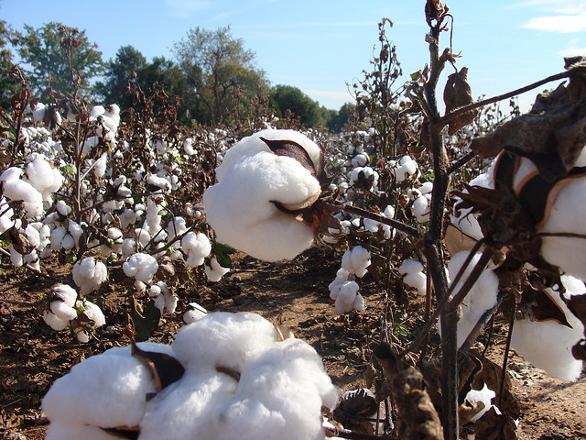
Phenological Cycles of Winter Wheat, Cotton, and Tobacco in South Carolina
Winter Wheat
Cotton
Tobacco
http://farm4.staticflickr.com/3137/
2997265506_1996582916_z.jpg
Jensen, 2000

Slide 8
What are Vegetation Indices?
A Vegetation Index (VI) is a “synthetic image layer” created from the existing bands of a multispectral image
This new layer often provides unique and valuable information not found in any of the other individual bands.
For example:
  VIs have been shown to quantify or predict vegetation biomass, productivity, leaf area, and/or vegetative ground cover.

Slide 9
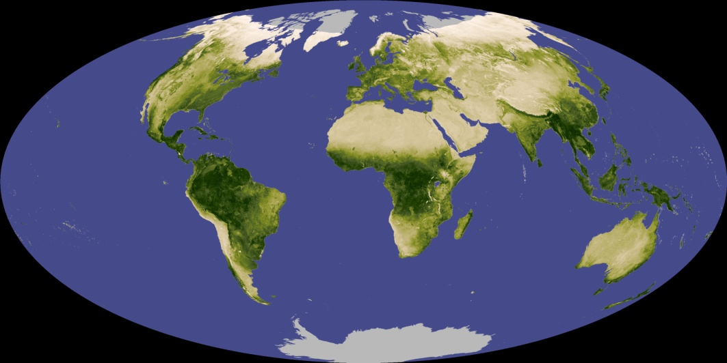
Normalized Difference Vegetation Index (NDVI)
NDVI is a simple numerical indicator that can be used to analyze remote sensing measurements, and
Assess whether the target being observed contains live green vegetation or not.

Slide 10
Normalized Difference Vegetation Index (NDVI)
Very low values of NDVI (0.1 and below) correspond to barren areas of rock, sand, or snow.
Moderate values represent shrub and grassland (0.2 to 0.3),
while high values indicate temperate and tropical rainforests (0.6 to 0.8).[1]

Slide 11
The most unique feature of the vegetation reflectance curve is the low red reflectance and high NIR reflectance.
Healthy Vegetation
l
Cover | NIR | Red | NIR/Red
Water | Low | Low | ~ 0.1
Soil | High | High | ~ 1
Vegetation | Very High | Low | Very High
i
o
e
S
r
a
y
B
r
D
0.4
Clear Water
2.6
Near Infrared
Mid Infrared
Wavelength (μm)
m)
Notes:
Health vegetation reflects strongly in the near-infrared portion of the spectrum while absorbing strongly in the visible red.
Other surface types, such as soil and water show near equal reflectances in both the near-infrared and red portions.
Thus, a ration image of Landsat MSS Band 7 (Near-Infrared-0.8 to 1.1 um) divided by Band 5 (Red-0.6-0.7um) would result in ratios much greater than 1.0 for vegetation, and
Rations around 1.0 for soil and water.
Thus the discrimination of vegetation from other surface types is significantly enhanced.
Also, we may be better able to identify areas of unhealthy or stressed vegetation, which show low near-infrared reflectance, as the rations would be lower than for healthy green vegetation.

Slide 12
Vegetation Indices (VIs)
There are several VIs, most are functionally equivalent
Most use a combination of the red and near infrared bands
  Simple Ratio (SR)
  Normalized Difference Vegetation Index (NDVI)
  Enhanced vegetation index (EVI)

Slide 13
Simple Ratio (SR)
Cohen (1991) suggests that the first true vegetation index was the Simple Ratio (SR)
Image ratioing serves to highlight subtle variations in the spectral responses of various surface covers.
Landsat: Band 4/Band 3
Notes:
NIR/Red (Landsat: Band 4/Band 3); brighter pixels are correlated with more biomass etc...
By ratioing the data from 2 different spectral bands, the resultant image enhances variations in the slopes of the spectral reflectance curves between the 2 different spectral ranges that may otherwise be masked by the pixel brightness variations in each of the bands.
Atmospheric corrections must be applied to the data before ratioing, otherwise the assumption that percent illumination variation is the same for each band is invalid.
Veg indices do not really measure vegetation or biomass, but measure reflection.
Another benefit of spectral ratioing is that, because we are looking at relative values (i.e. ratios) instead of absolute brightness values, variations in scene illumination as a result of topographic effects are reduced. Thus, although the absolute reflectances for forest covered slopes may vary depending on their orientation relative to the sun's illumination, the ratio of their reflectances between the two bands should always be very similar.

Slide 14
Normalized Difference Vegetation Index (NDVI)
Rouse et al. (1974) developed the generic NDVI
NDVI values are real numbers ranging from -1 to 1,
  Well vegetated areas have higher values (NIR >> red reflectance)
  Water (and sometimes shadow) have negative values (red reflectance > NIR reflectance)
  Rock, dry soil, and senesced vegetation have values near zero (red reflectance = NIR reflectance).
Notes:
More common is the Normalized Difference Vegetation Index (NDVI).
The NDVI index was widely adopted and applied to the original Landsat MSS data.

Slide 15
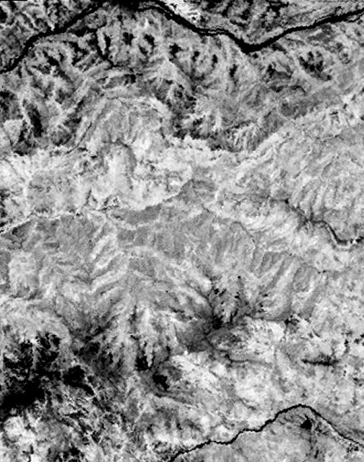
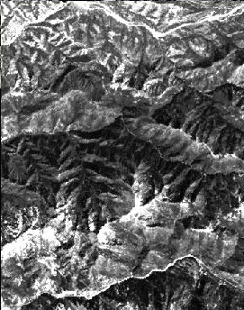
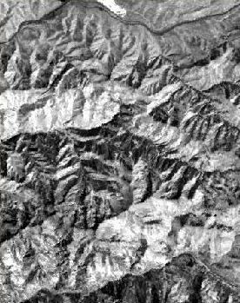
Example NDVI Image
Red
Near Infrared
NDVI

Slide 16
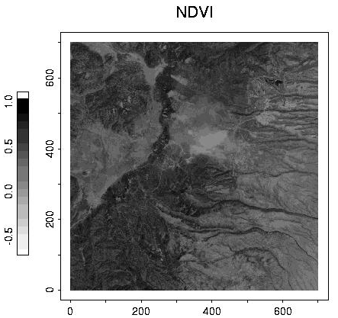

Slide 17
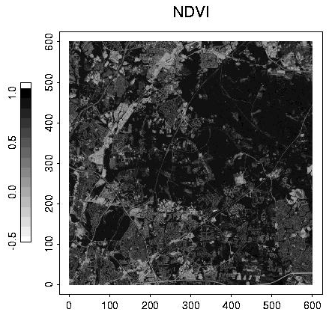

Slide 18
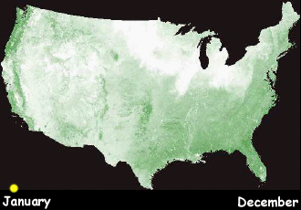
NDVI of AVHRR Imagery
Progression through the season...
Low NDVI VALUE High

Slide 19
Enhanced Vegetation Index (EVI)
Where C1, C2 coefficients adjusting for atmospheric effects and L is a soil adjustment factor.
They are empirically determined as C1=6.0, C2=7.5 and L=1.0.
EVI has improved sensitivity to high biomass regions.
Huete and Justice, 1999 MODIS vegetation index.
http://modarch.gsfc.nasa.gov/MODIS/LAND/#vegetation-indices

Slide 20
Transformed Vegetation Index (TVI)
Deering et al. (1975) defined the TDI
0.5 is added to the NDVI; the square root of the result is utilized to stabilize the variance

Slide 21
In addition to the standard VIs, there are several transformation equations that each create several new images.
Linear transformations
  PCA (principal component analysis)
  K-T (Kauth-Thomas) – Tasseled cap transform

